Slide 1
Unit 2: Constitutional Foundations (1763-1824)
Unit Essential Questions:
Why did the American colonists “break up” with Great Britain?
How do you balance freedom with a working government?
Has the U.S. lived up to the ideals in the Declaration of Independence and the Constitution?

Slide 2
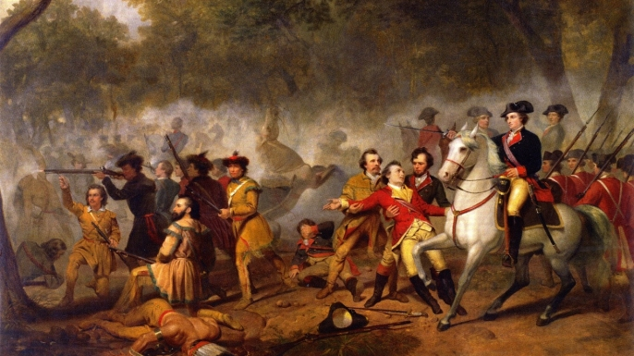
French & Indian War (7 Years’ War) 1754-1763

Slide 3
Learning Objectives
What were the causes of the French & Indian War?
Why did the colonists try to unify during the French & Indian War?
What were the effects of the French & Indian War?

Slide 4
Causes of the French & Indian War
France & Great Britain were traditional European rivals
Disagreements over land settlements (upper Ohio River Valley)
Small group of British colonists ambushed a French scouting party in Pennsylvania (Battle of Jumonville Glen)
War broke out between French/Indian allies & Great Britain/colonies/Indian allies

Slide 5
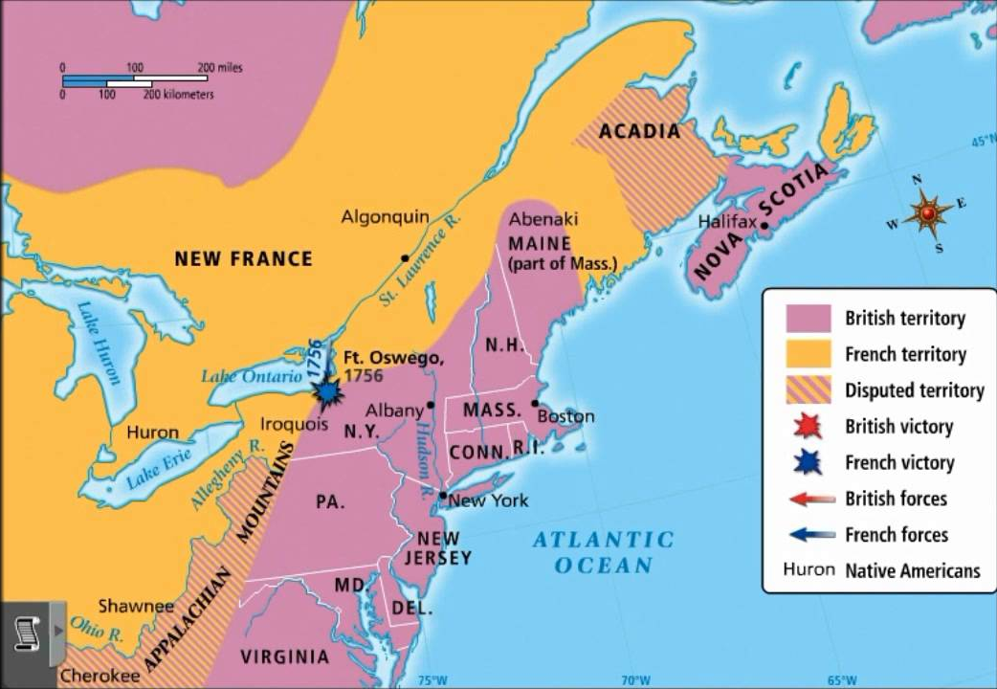

Slide 6
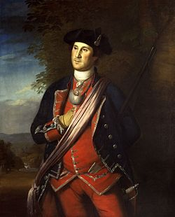
Battle of Jumonville Glen
https://www.youtube.com/watch?v=Jz85GFuan48

Slide 7
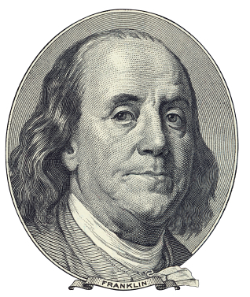
Albany Plan of Union – June 1754
Members from 7 of the northern colonies met in Albany, NY
Wanted to strengthen alliance with the Iroquois
Discussed a permanent alliance between the British colonies
Still loyal to Great Britain
Alliance of colonies could better fight the French
Rejected by the colonies

Slide 8
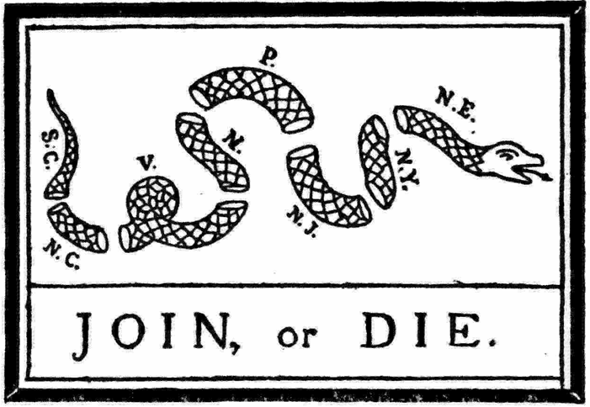
Benjamin Franklin, May 1754

Slide 9
Course of the War
The French were winning the war early on
In response, British Prime Minister, William Pitt, poured more money and resources into the war
In 1759, the British captured Quebec, the capital of New France

Slide 10
Results of the War
The Treaty of Paris ended the war in 1763
New territory for Great Britain and the colonies
Present-day Canada
France dropped all claims to land east of the Mississippi
Debt for Great Britain!
American colonists (slightly) unified to help fight the French
Great Britain owns North America!

Slide 11
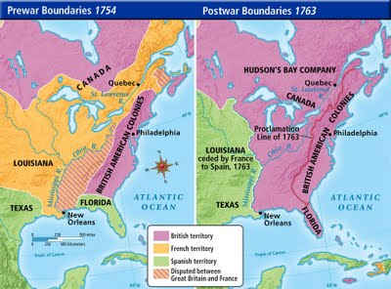

Slide 12
Exit Ticket
Without looking at your notes, list 1 cause and 2 effects of the French and Indian War

