Slide 1
1920s
Politics, Economics, & Culture

Slide 2
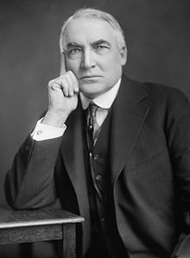
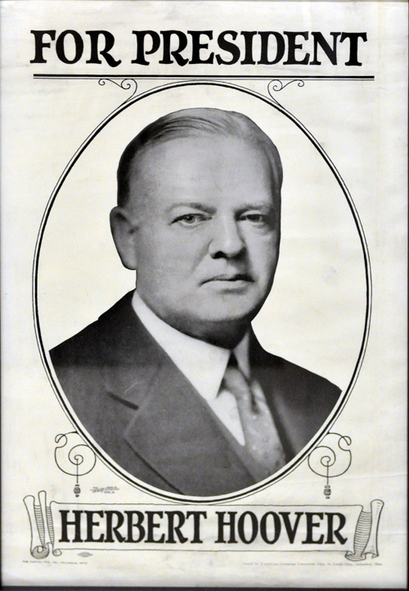
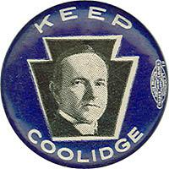
Who was President During the 1920s?
Three Presidents served during the 1920s
Warren G. Harding (1921-1923)
Calvin Coolidge (1923-1929)
Herbert Hoover (1929-1933)

Slide 3
1920s Politics
Harding, Coolidge, and Hoover all wanted a “return to normalcy” after the conclusion of the Progressive Era and World War I
Their policies followed a “laissez-faire” approach that limited the size of the government, cut taxes, and instituted tariffs
This approach would result in a decade of economic boom that became known as the “Roaring Twenties”

Slide 4
1920s Economic Boom
The 1920s saw industries like automobiles, steel, and oil prosper
Henry Ford used the assembly line to mass produce cars
By 1927, there were over 15 million cars in the United States
The development of cars and better roads increased the number of people living in the suburbs and allowed Americans to go on “modern” vacations

Slide 5
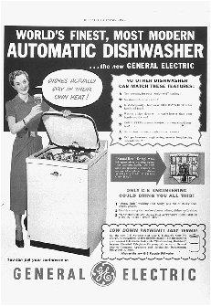
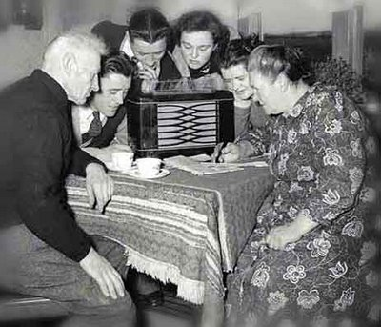
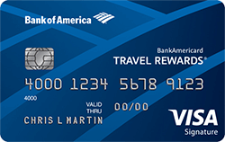
Consumerism
The economic boom of the 1920s led to increased consumerism, or the increased production and buying of new goods like automobiles, radios, washing machines, refrigerators, etc.
Americans bought many of these goods on “credit,” or money that would be paid back later with interest

Slide 6
The Stock Market
Many people began purchasing stocks during the 1920s
A stock is a share in a corporation – if you sell the stock for more than you bought it for, you make a profit
Consumerism attitudes led to people buying stocks with credit – they “bought on margin,” meaning they paid off the stock purchase over time
Overall, Americans during the 1920s had a “buy now, pay later” mentality

Slide 7
1920s Culture
American culture drastically shifted during the 1920s, resulting in a clash between traditional beliefs and modern ideas

Slide 8
The Scopes “Monkey” Trial (1925)
Tennessee passed a law called the Butler Act that made it illegal for public school teachers to teach evolution
A teacher named John Scopes decided to teach the theory of Darwin’s Evolution
He was arrested, found guilty, and charged a fine of $100
The trial showed the clash between religious fundamentalism (traditional beliefs) and modern scientific theory

Slide 9
Leisure Time
Americans living in cities had more free time during the 1920s than ever before
Why?
New consumer goods made life easier – household chores could be done more quickly
Factory jobs had set hours that had now been limited to 8 hours/day thanks to the Progressive Era

Slide 10
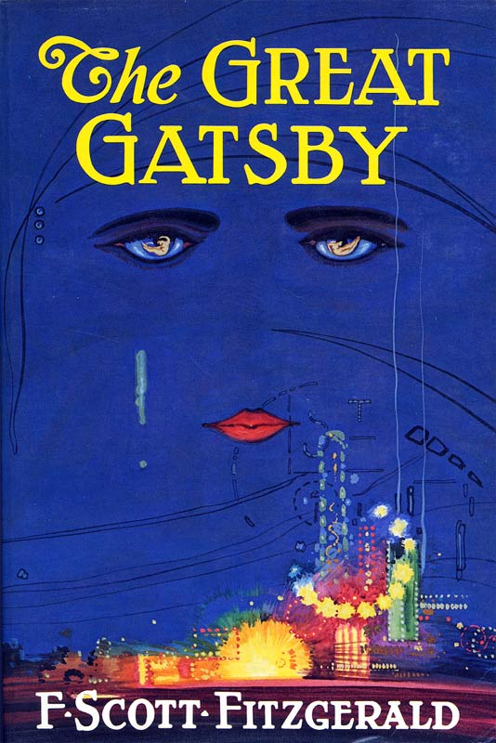
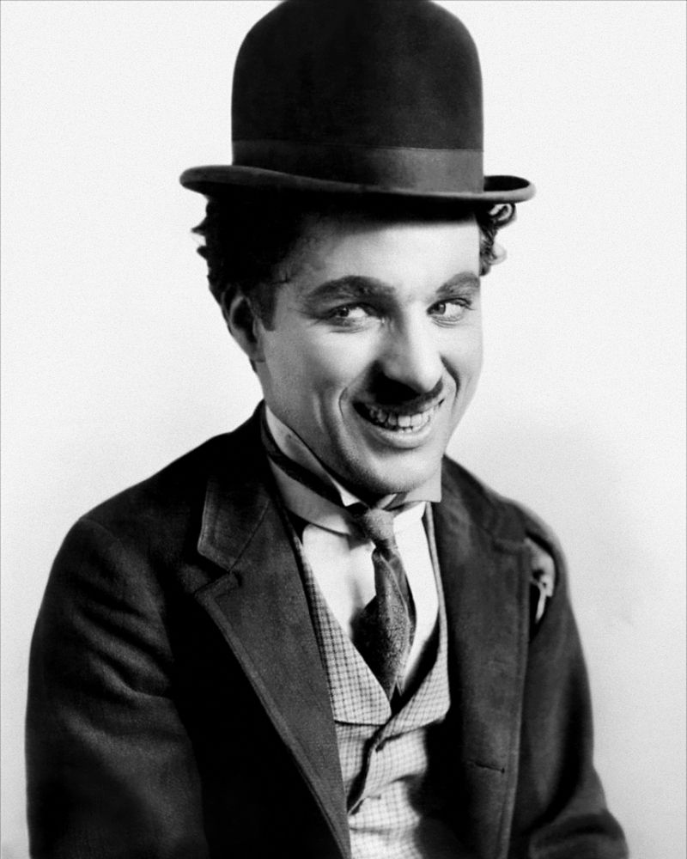
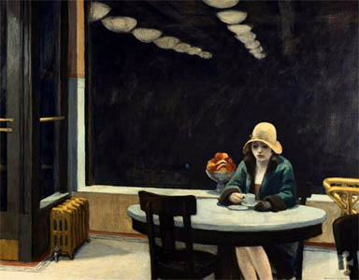
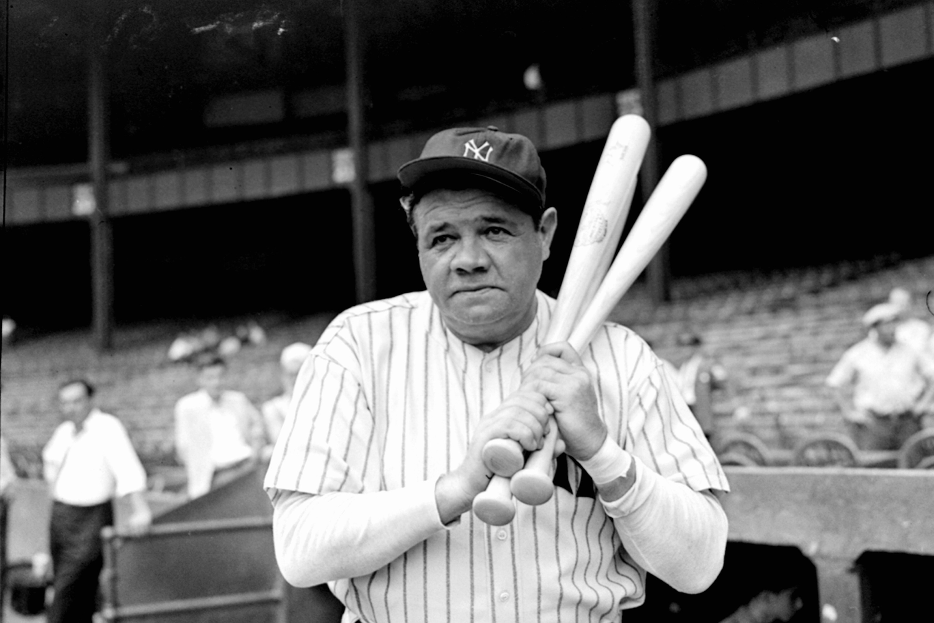
Leisure Time
Leisure time meant more time for creativity, movies, and sports

Slide 11
The Harlem Renaissance
The 1920s also saw a movement among African Americans called the Harlem Renaissance
In response to segregation and racism, African Americans created a social and cultural identity
They created art, literature, and music that still influences American culture today

Slide 12
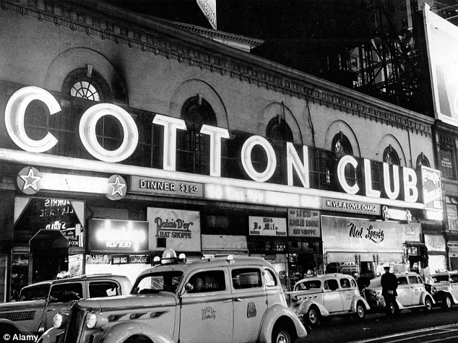
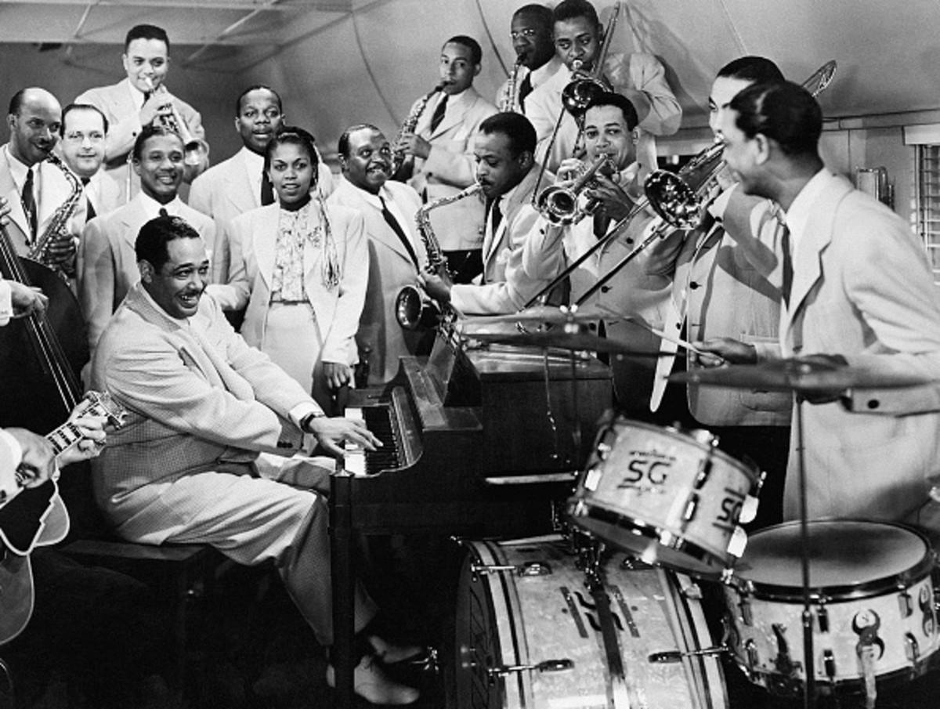
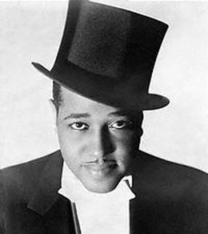
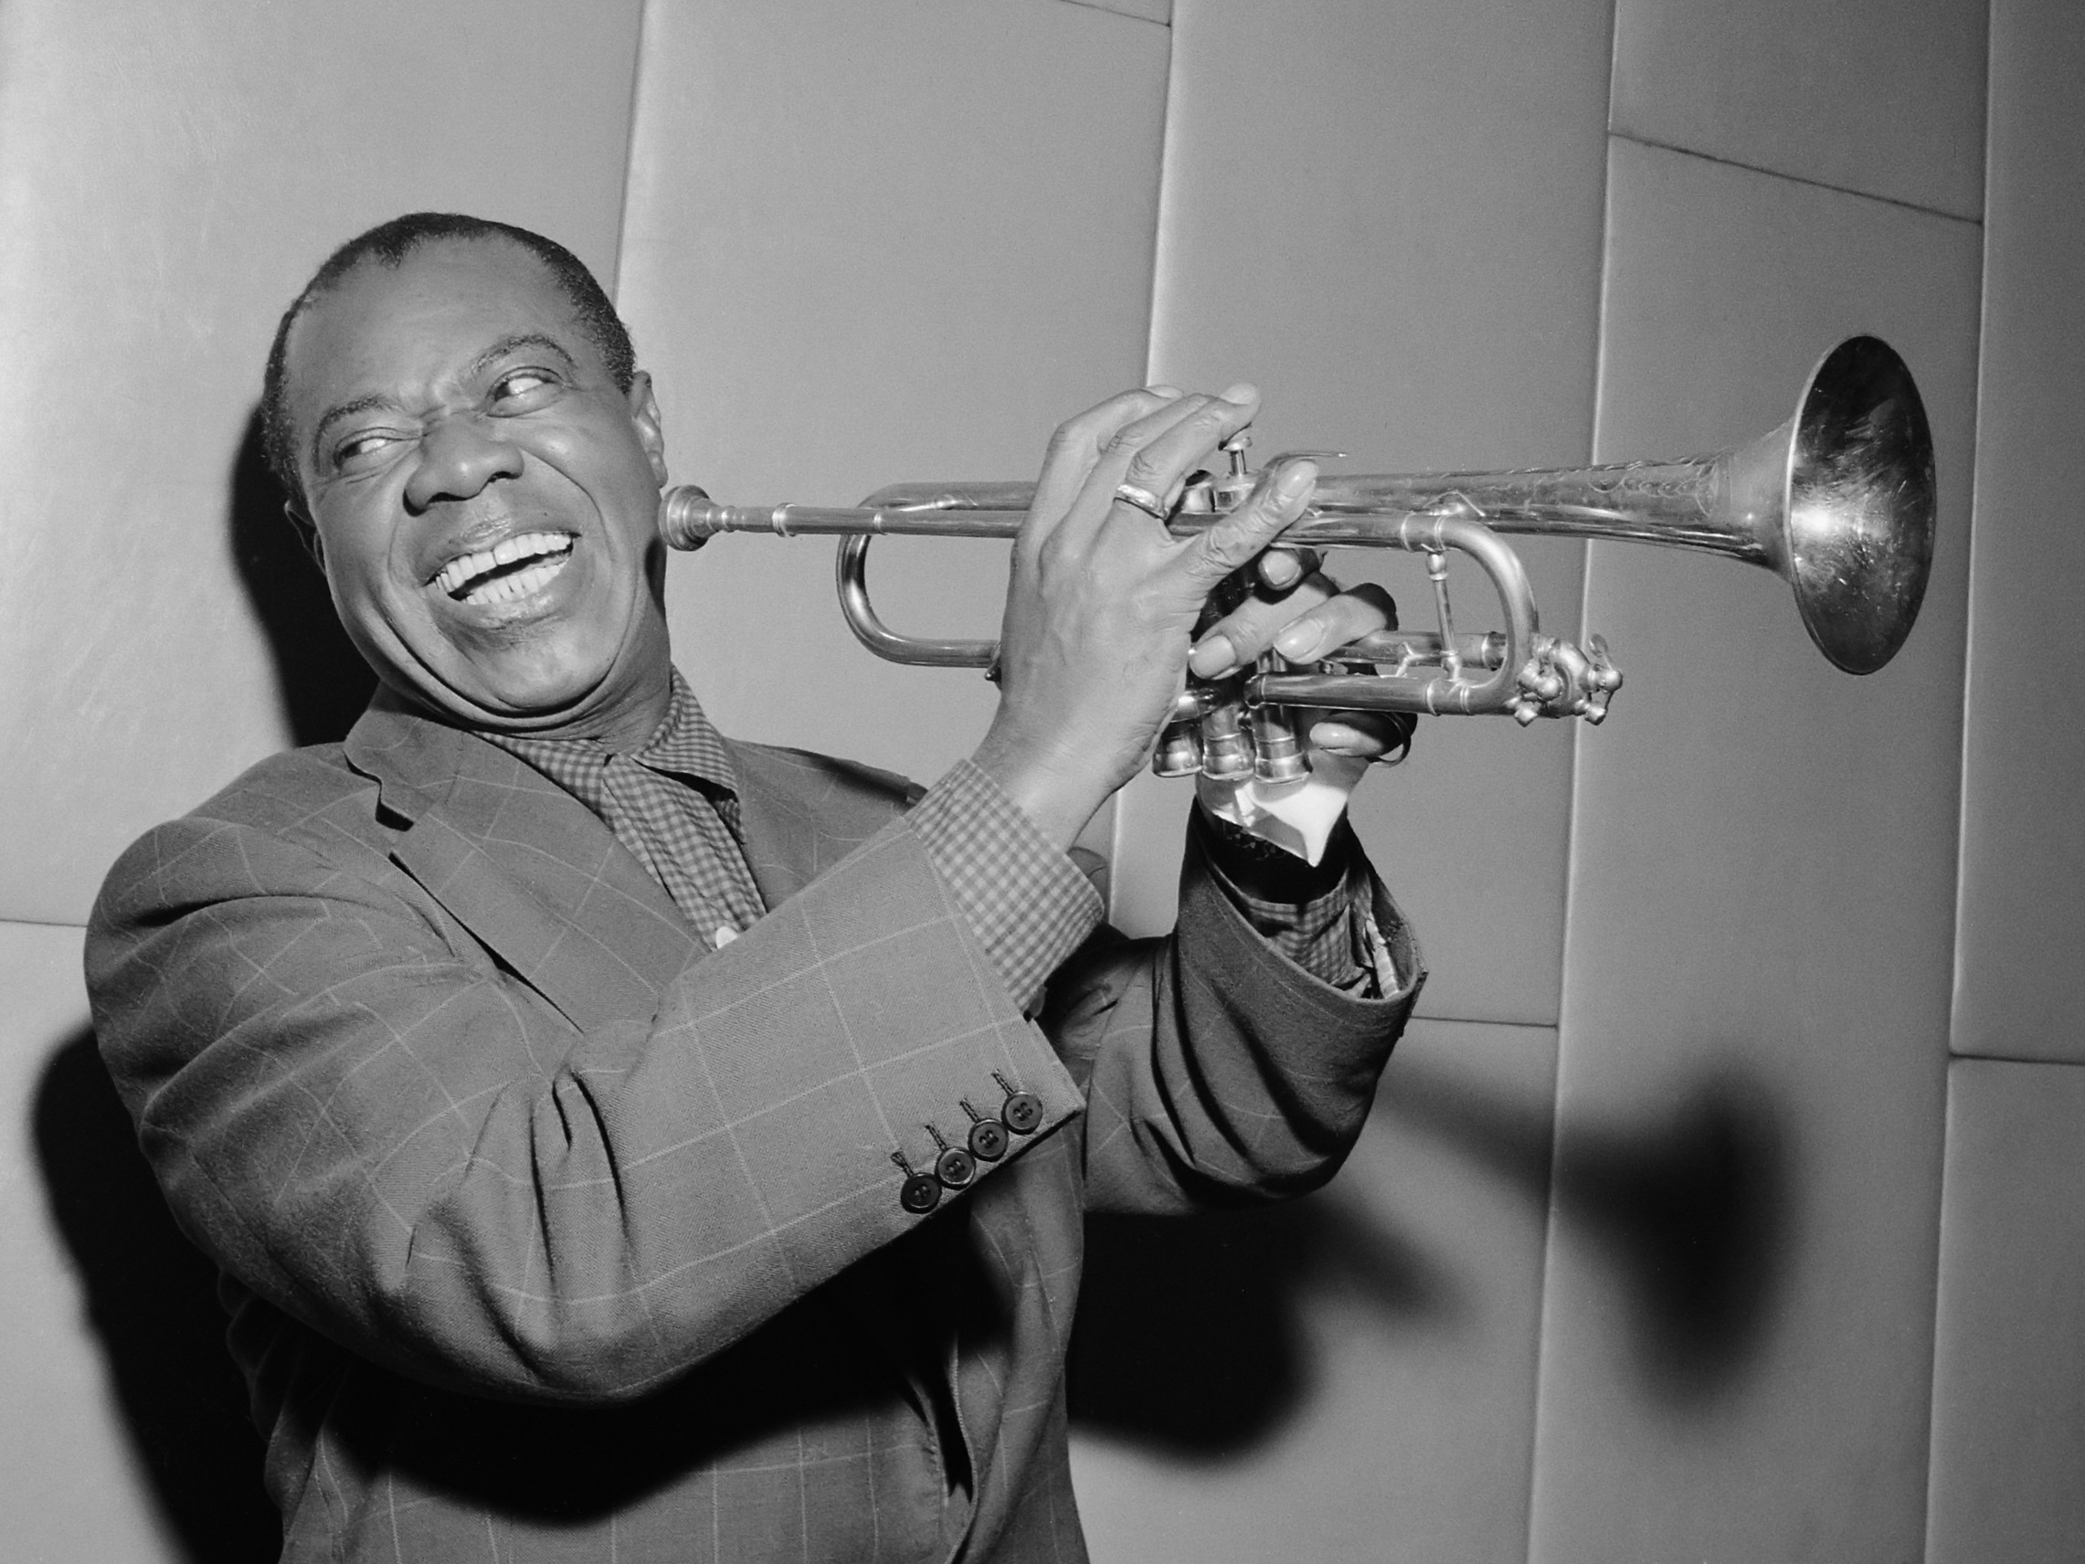
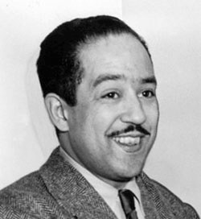
Jazz Music
Duke Ellington
Louis Armstrong
Langston Hughes

Slide 13
On the back of your notes sheet…
Categorize the listed terms into political, economic, or social factors of the 1920s
Choose one factor and describe how it was a cause for a different factor
Example: “Laissez faire economic policies resulted in consumerism because…”

Slide 14
https://www.youtube.com/watch?v=RN7ftyZigYs

