Slide 1
Unit 2: Budgeting
Making Your Money Work For You

Slide 2
What is a Budget?
z

Slide 3
Learning Objectives
What is a budget?
What is the difference between income and expenses?
What is an Emergency Fund?

Slide 4
A budget is a schedule of your income and expenses, usually over the course of a month
Individuals, families, businesses, and governments all use budgets to manage their finances
A budget accounts for costs associated with: housing, transportation, insurance, food, entertainment, debt, savings, etc.

Slide 5
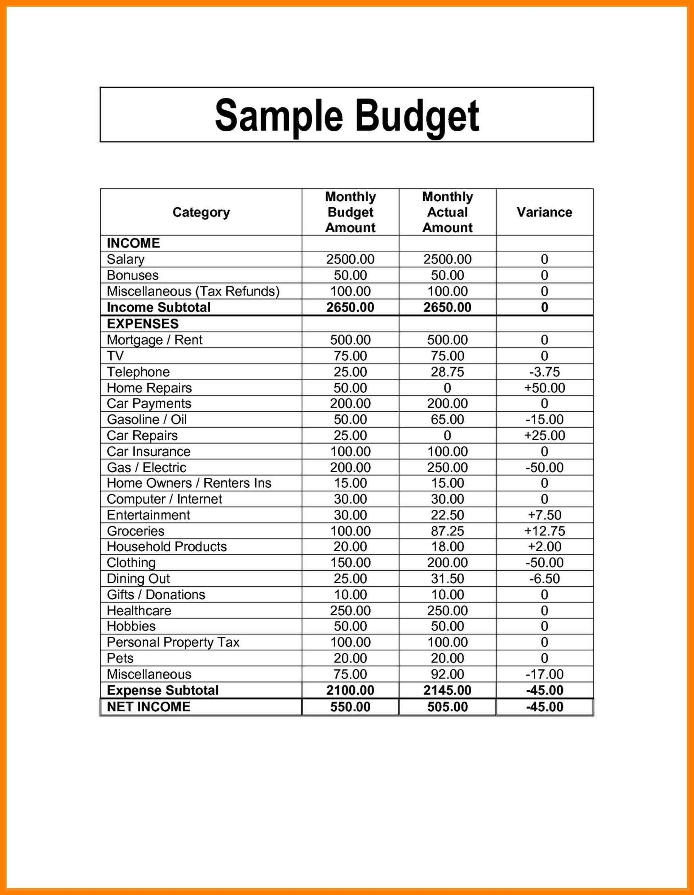

Slide 6
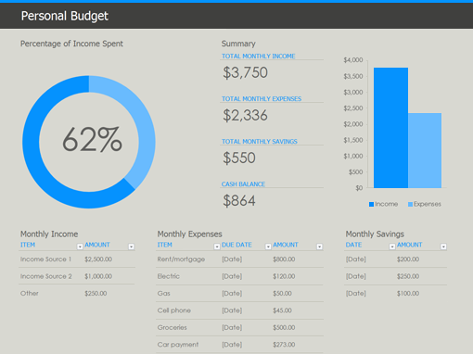

Slide 7
Income vs. Expenses
Income
Expenses
Any money that you earn or gain (put into your "pocket")
Wages/salary
Interest on bank account
Unemployment compensation
Gambling (lottery)
Any money that you spend (take out of your "pocket")
There are many different types of expenses

Slide 8
If your INCOME is LESS THAN your EXPENSES, you must EARN MORE or SPEND LESS
z

Slide 9
Types of Expenses
Fixed Expenses
Variable Expenses
An expense that is the same amount every time you pay it
An expense that fluctuates in its amount

Slide 10
Types of Expenses
Routine
Non-Routine
You pay on the same date every month
Can be fixed or variable
Examples include rent/mortgage, electric bill, cell phone bill, Internet bill
You don't know when you will have to pay for these expenses
Can be fixed or variable
Examples include medical co-pay (fixed), car maintenance (variable), gifts (variable), fundraisers (variable)

Slide 11
EMERGENCY FUND
It is vital that you account for an emergency safety fund in your budget
Should initially be about 1000 dollars
Eventually, you want your Emergency Fund to have at least 6 months' worth of expenses in it
This fund should ONLY be used for emergencies!
It should be separate from your normal money, but accessible
If you must use some of the money, you should replenish it as quickly as possible

Slide 13
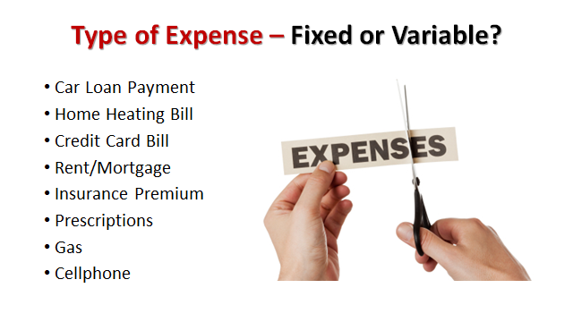

Slide 15
Income
Gross Pay
Net Pay
The total amount of money you earn in salary/wages before deductions are taken out
Federal & State Taxes, Health Insurance, Retirement, Union Dues, Child Support are all deductions
The total amount of money you take home in your paycheck after deductions

Slide 16
Spending Ratio
The percentage of money you should be paying for certain expenses relating to your gross income
Housing (including rent/mortgage, electric, Internet, phone, heat, garbage) should NOT be higher than 30% of your gross income
Transportation (including auto loan, insurance, gas, tolls) should NOT be higher than 20% - 25% of your gross income
Debt payments should NOT be higher than 5%-10% of your gross income
Savings should account for AT LEAST 10% of your gross income

