Slide 1
Take and Complete the DO NOW on the Kansas-Nebraska Act

Slide 2
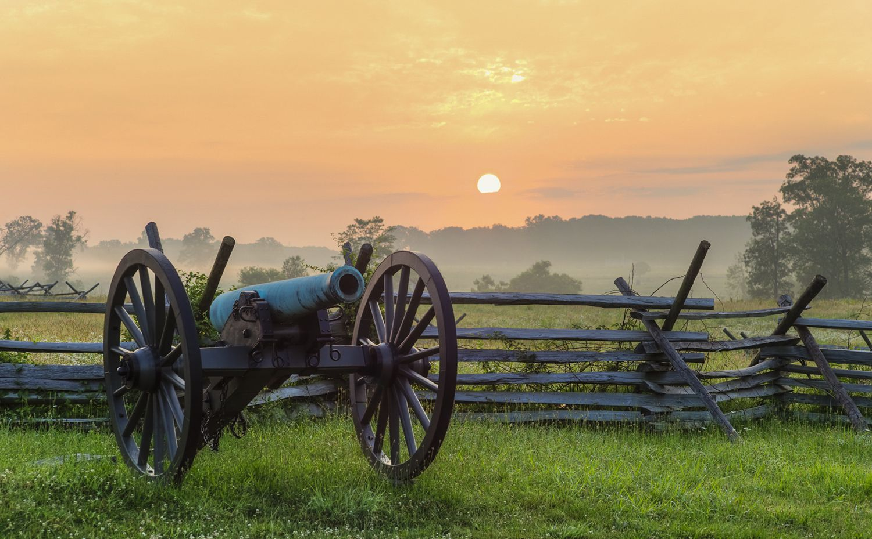
The Civil War Erupts

Slide 3
Causes of the Civil War: Sectionalism
Expansion from the Louisiana Purchase, Mexican-American War, Gold Rush, and Manifest Destiny led to more debate about where slavery would be allowed
The economies of the north and south were vastly different: the north was industrial while the south relied on agriculture and slavery
The Missouri Compromise and the Compromise of 1850 were both temporary political fixes that kept the nation together by balancing power between slave and free states, but both ultimately failed
The Dred Scott Case, Kansas-Nebraska Act, Uncle Tom’s Cabin, and Abolitionist Movement all created more tension between the free north and the slaveholding south

Slide 4
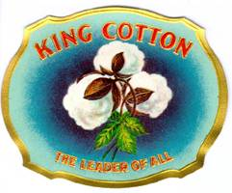
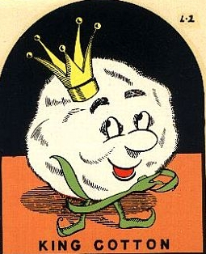
Economic Differences: King Cotton
The Southern economy was dependent on rural plantations
The major cash crop of the time was cotton, which was exported to the North and England for textile (clothes) production
The cotton gin, invented by Eli Whitney, made growing cotton more efficient and increased the demand for slave labor

Slide 5
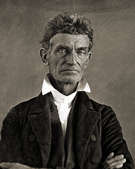
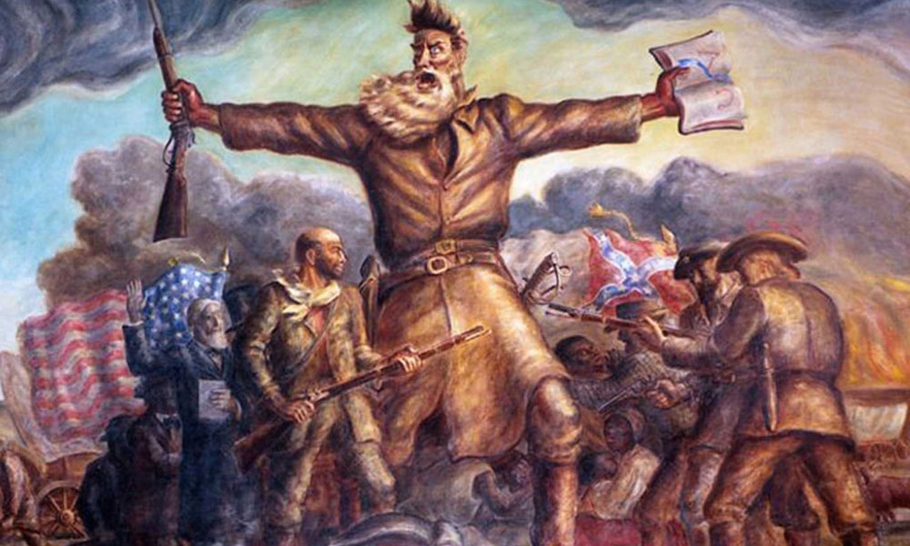
Violence Erupts in “Bleeding Kansas”
John Brown
https://www.youtube.com/watch?v=7tJ0ZjRxKhs

Slide 6
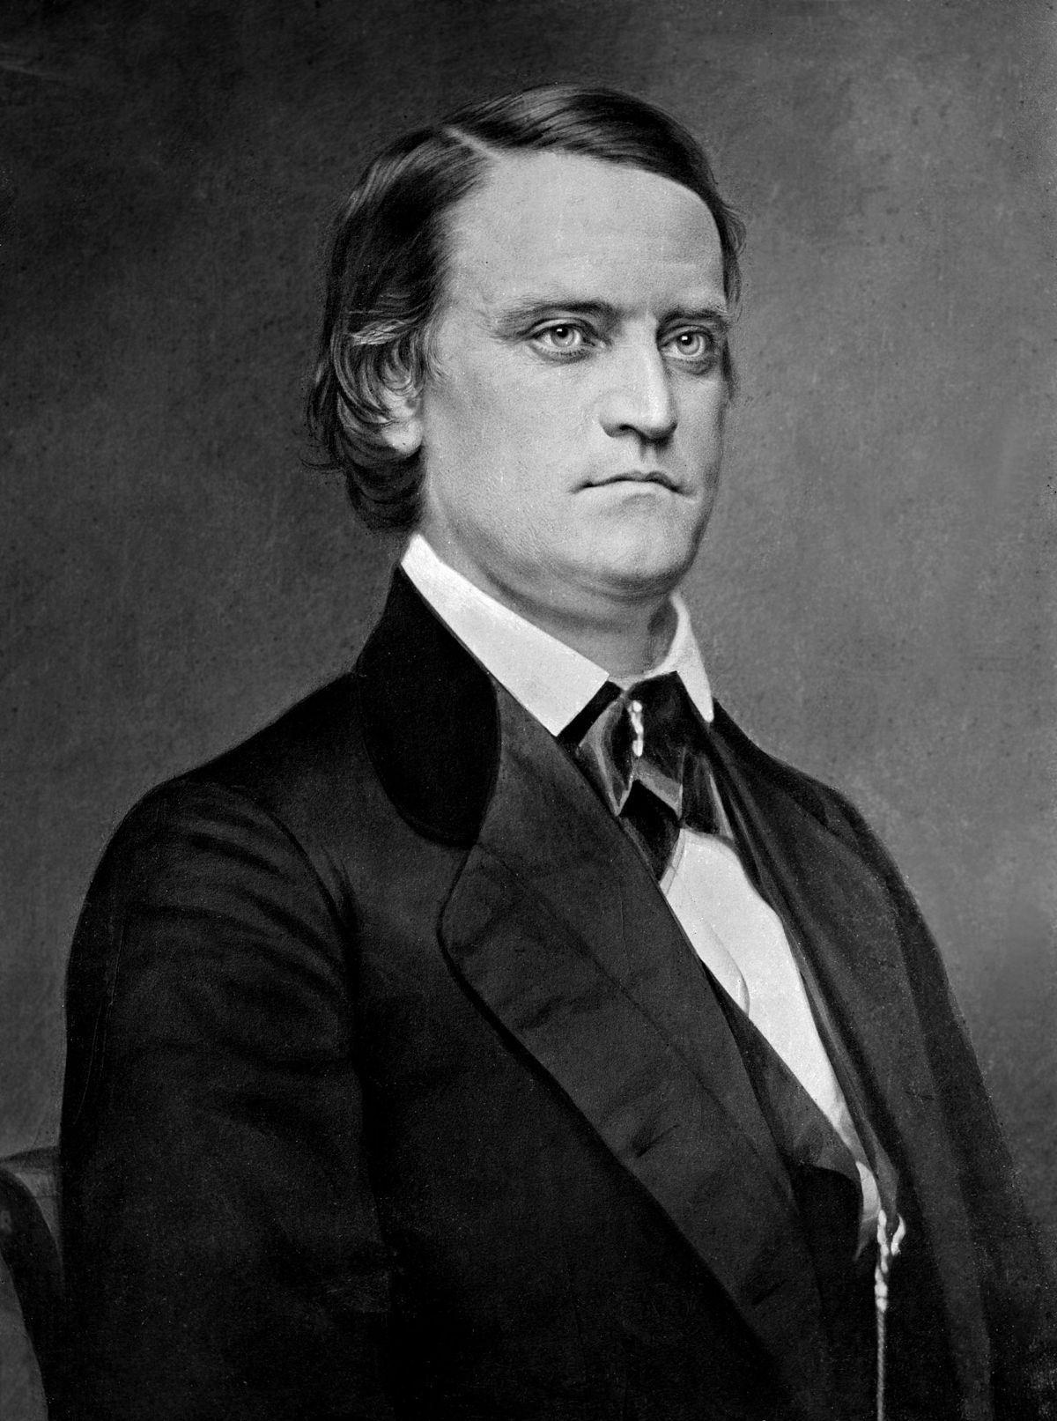
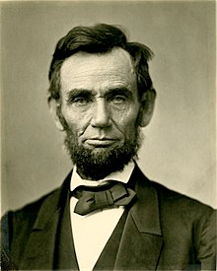
Causes of the Civil War: Election of 1860
J.C. Breckinridge
(Southern Democrat)
Abraham Lincoln
(Republican)

Slide 7
Causes of the Civil War: Election of 1860
J.C. Breckinridge was committed to expanding slavery
Abraham Lincoln had famously argued against the expansion of slavery during the Lincoln-Douglas Debates during the 1858 Illinois Senate race
Lincoln received the 180 electoral votes required to win the Presidency
He only won 39% of the popular vote and did not a single southern state
In fact, Lincoln received zero votes in 10 of the 15 southern states!

Slide 8
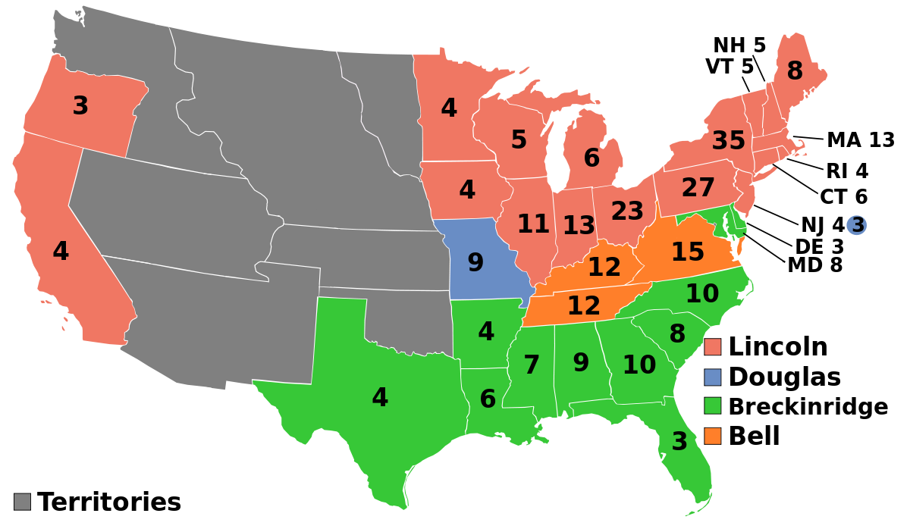

Slide 9
Causes of the Civil War: The Secession Crisis
The South was outraged that someone could become the President without winning a single southern electoral vote
South Carolina seceded from (left) the United States of America on December 20, 1860 in response to Lincoln’s election
10 more southern states would secede by June of 1861 and form the Confederate States of America
Jefferson Davis was elected President of the Confederacy

Slide 10
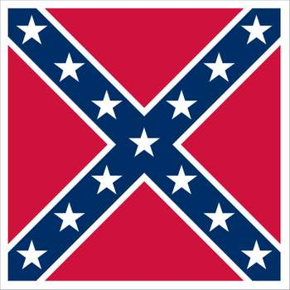
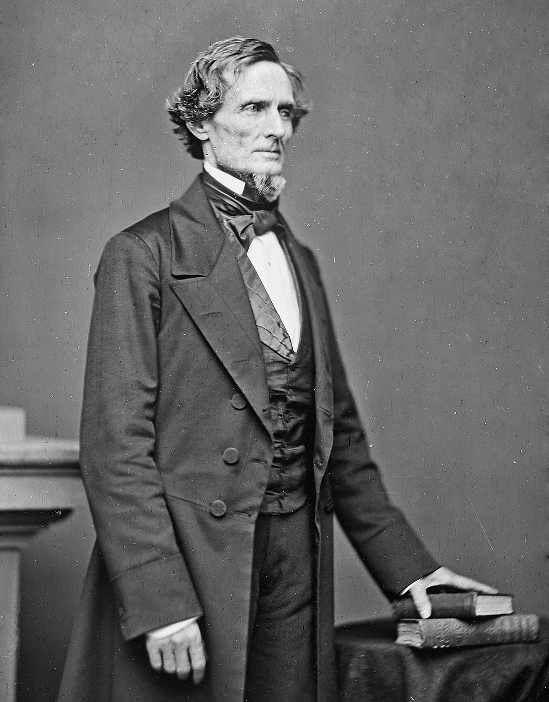
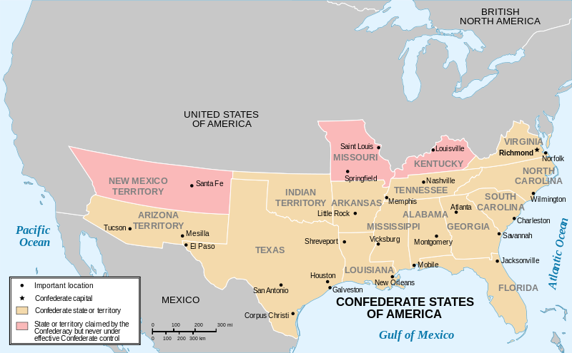

Slide 11
Causes of the Civil War: Fort Sumter
In his Inaugural Address, Lincoln sought peace with the southern states that had seceded from the Union
1 month later, Confederate troops attacked the Union fort, Fort Sumter in South Carolina
The Confederacy had now committed an act of open war against the Union
On July 25, 1861, the United States of America declared it would fight a Civil War to preserve the Union

Slide 12
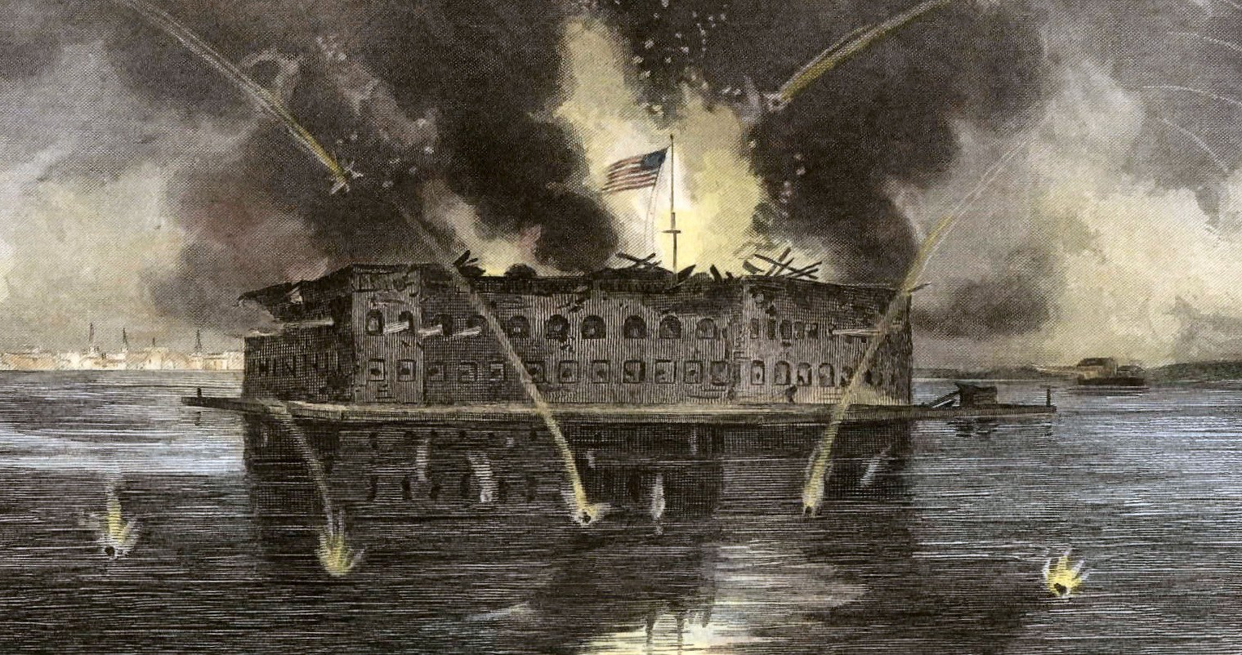
https://www.youtube.com/watch?v=c3IwgtrMKKM

