Slide 1
Colonial Politics
What Did the Colonists Believe?

Slide 2
Today's Learning Objectives
Identify what influenced political beliefs in the British colonies
Explain why democracy and self-government evolved in the British colonies

Slide 3
Democracy
What is “democracy?”
A system of government in which all members of society have a say
What is “representative government?”
A system of government in which citizens vote to elect people to represent them and make laws on their behalf

Slide 4
Rights as English Subjects
Magna Carta
English document from way back in 1215
Limited the King's ability to tax
Guaranteed nobles the right to a trial
English Bill of Rights
Extended the rights in the Magna Carta to all English citizens
Said the King couldn't keep a standing Army
BOTH OF THESE LIMITED THE POWER OF THE KING

Slide 5
Self-Government
Because they were thousands of miles from England, the colonists began to create their own ways of running their governments
Many of the colonies began electing their own leaders
Because they were still part of the British Empire, the colonists still had the same rights as English citizens living in England
Democracy in the Early British Colonies

Slide 6
Democracy in the Early British Colonies
Mayflower Compact
House of Burgesses
Agreement created by the Pilgrims who landed at Plymouth
Set up a governing body for the new colony
One of the earliest examples of democracy in the colonies
Women were excluded from signing the compact!
First representative legislative (lawmaking) body in the British colonies
One of the earliest examples of representative government in the colonies
White, male landowners elected people to work with the governor of Virginia to solve issues

Slide 7
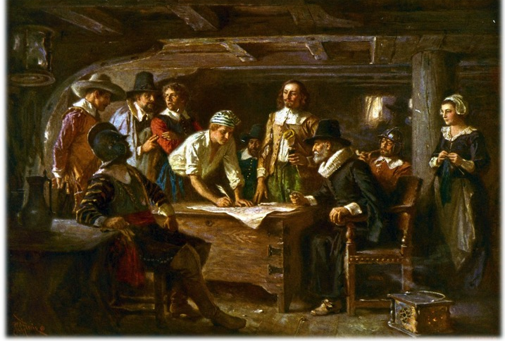
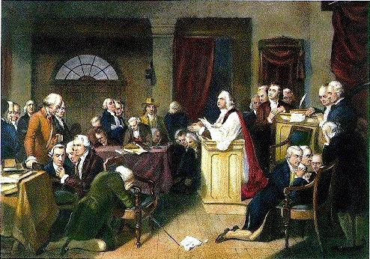
How are the Mayflower Compact and the House of Burgesses examples of early democracy?
How are they limited in terms of democracy?

Slide 8
Town Meetings
Salutary Neglect
England avoided strict enforcement of laws in the colonies with the understanding that the colonists would still be part of England. This leniency allowed the colonies to continue to practice democracy and self-government
In New England, colonists would gather to discuss and solve local issues
Democracy in the Early British Colonies

Slide 9
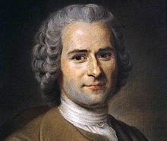
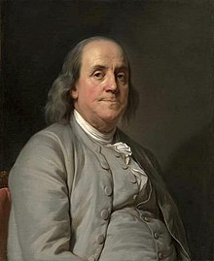
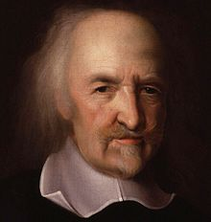
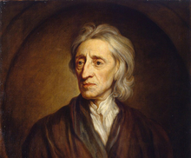
Benjamin Franklin's Celebrity Crushes
Jean Jacques Rousseau
John Locke
Thomas
Hobbes

Slide 10
Why Did Ben Franklin Love These Dudes?
Locke, Hobbes, and Rousseau argued:
People are born with natural rights that the government cannot take away
Government is a social contract that requires the consent of the governed

Slide 11
A Man Named Zenger
In 1734, John Peter Zenger called the Governor of New York an idiot. Here's what happened next...

