Slide 1
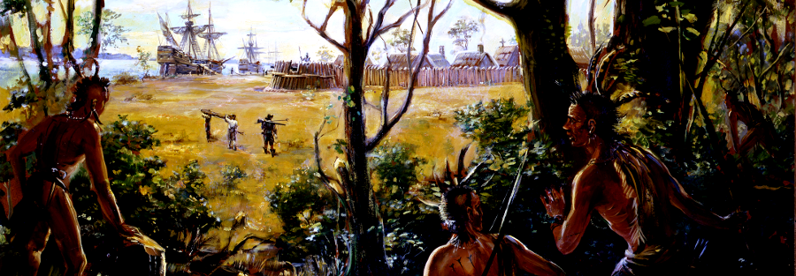
Unit 1: Colonial Foundations
1607-1763

Slide 2
Unit Essential Questions
Why did Europeans move to the New World?
What happens when two completely different cultures (Europeans and Native Americans) meet?
How did geography affect the American colonies?
What is democracy? Why did democracy develop in the American colonies?

Slide 3
Today’s Learning Objectives
Define the term “colony”
Define the term “mercantilism” and explain why a nation like England would want to create a colony
Explain why Spain colonized the Americas

Slide 4
Brain Dump – What is a Colony? Why make one? Examples of colonies?

Slide 5
What is a colony?
A colony is an area settled by immigrants that continues to be ruled by the “mother country”

Slide 6
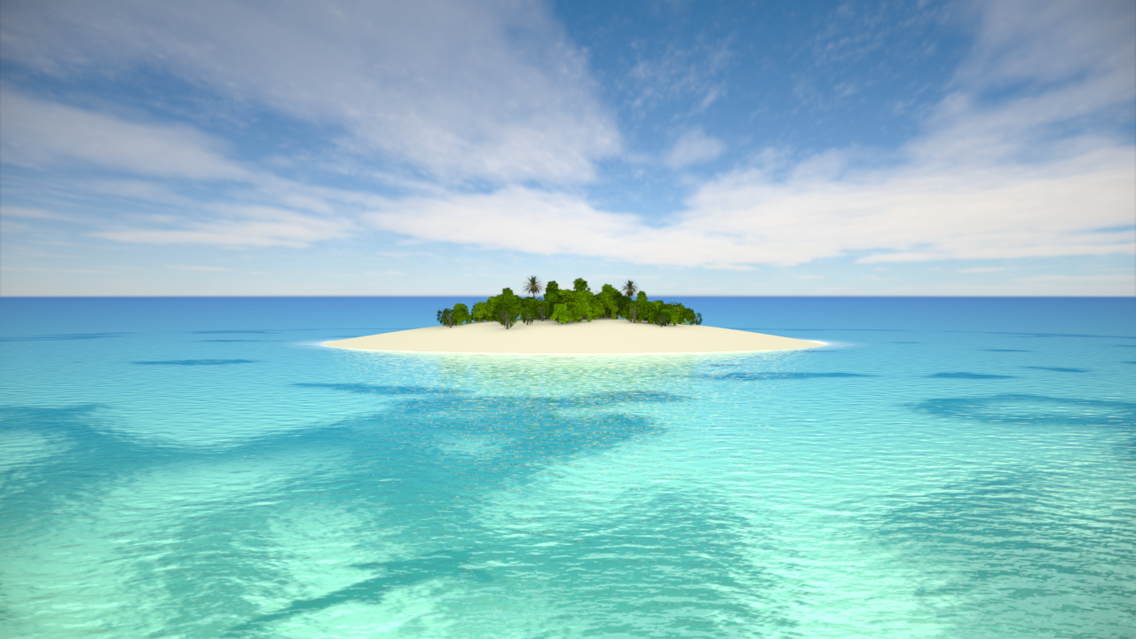

Slide 7
Why establish a colony?

Slide 8
Mercantilism
Mercantilism is an economic theory that stresses profitable trade as the method for accumulating wealth (money)
For trade to be profitable, a country’s exports must be greater than its imports – this is favorable for the mother country
The best way to achieve this was for a nation to establish a colony that it could trade with

Slide 9
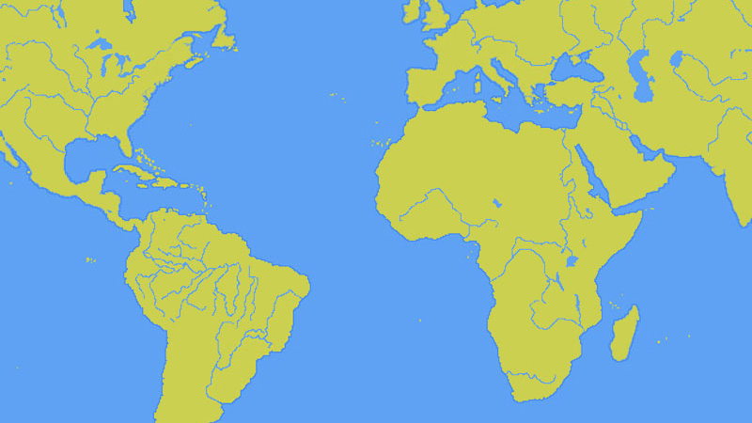
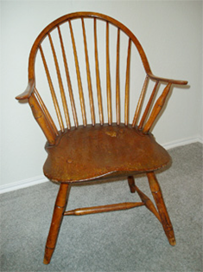
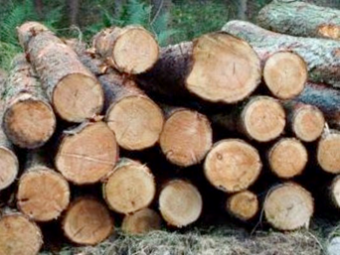
Finished Products
Raw Materials
Raw Material
$
Finished Product
$$$

Slide 10
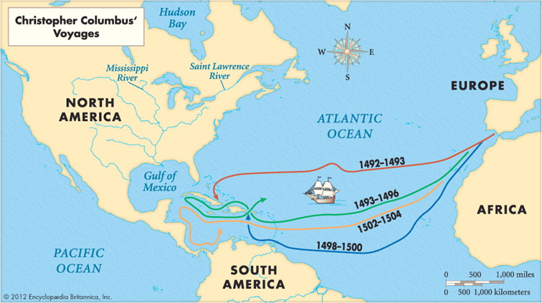
Christopher Columbus' "discovery" of the New World sets the stage for European colonization

Slide 11
Spain in the New World – CONQUEST!
Conquest is taking over a place with the use of military force
The goal of conquest is to acquire natural resources and wealth
The people who live in the place being conquered are often captured and enslaved or killed

Slide 12
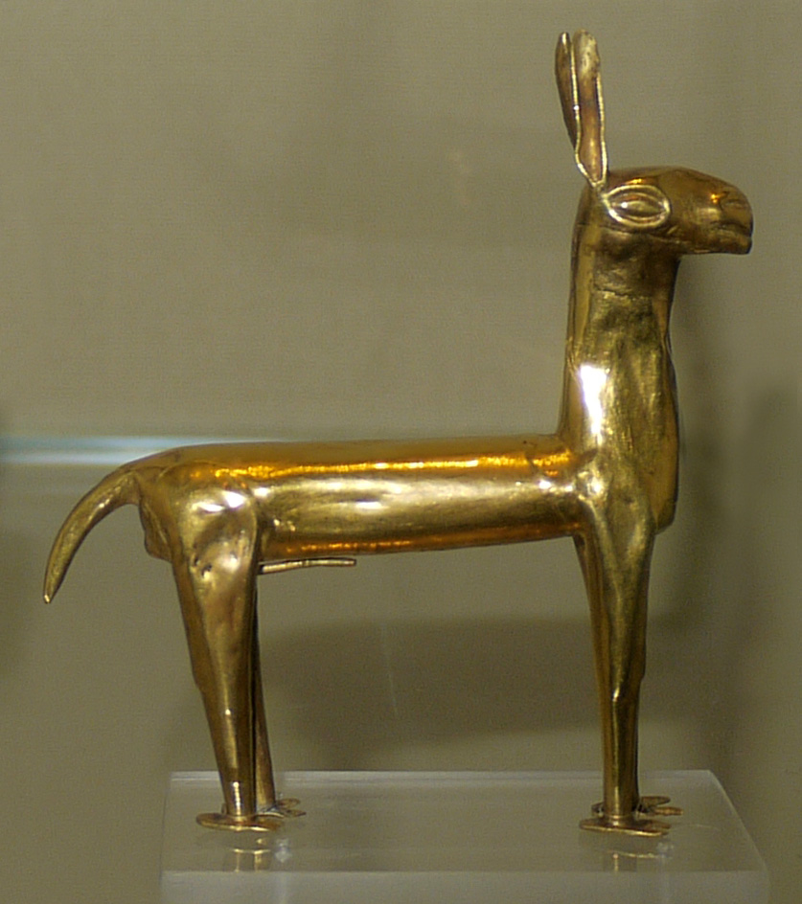
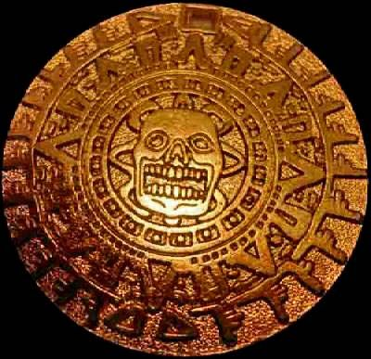
Spain became obsessed with acquiring gold from the Native Americans who lived in the Americas

Slide 13
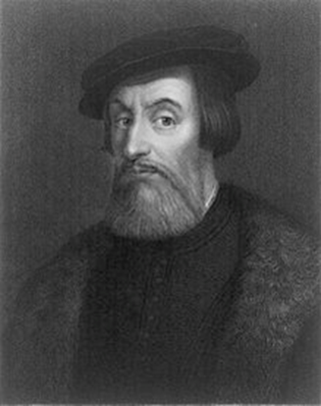
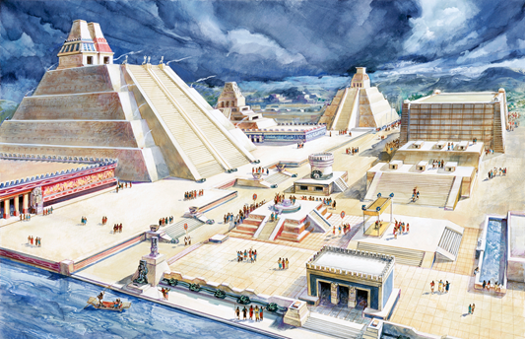
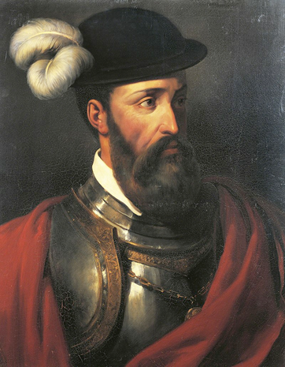
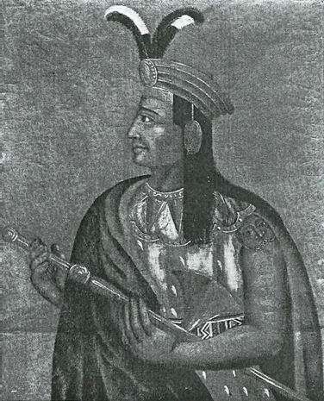
Spanish Conquistadors went to the New World looking for ‘God, Gold, & Glory’
Francisco Pizzaro captured and killed Atahualpa, the Incan emperor & conquered the Incan Empire
Hernan Cortes conquered the Aztec Empire

Slide 14
How did Spain conquer the Native Americans?
Better weapons – steel and firearms
Native American allies – many Native Americans opposed the Incan and Aztec Empires
Diseases – illnesses that the Spanish were used to devastated Native American populations

Slide 15
English Colonization
While Spain colonized South and Central America, England colonized the east coast of North America
The first successful English colony in North America was Jamestown, located in Virginia
Here, the colonists relied on assistance from local Native Americans and the cash crop tobacco
Eventually, England would colonize the entire east coast and establish the 13 British colonies

Slide 16
