Slide 1
Take and complete the sheet from the front of the room
If you did not hand in the reading questions yesterday, put them in the box

Slide 2
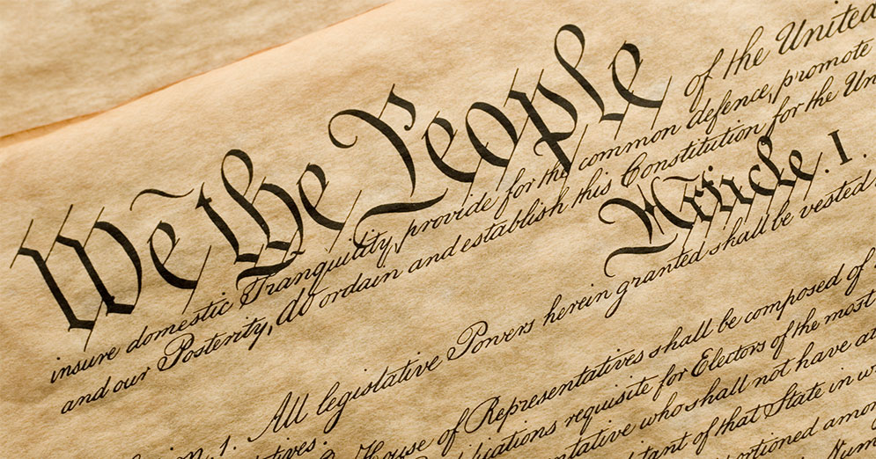
The U.S. Constitution
The Blueprint for the United States of America

Slide 3
The Constitutional Convention - 1787
Leaders from the individual states met in Philadelphia to fix the Articles of Confederation
They realized the Articles were a complete failure and decided to write an entirely new Constitution

Slide 4
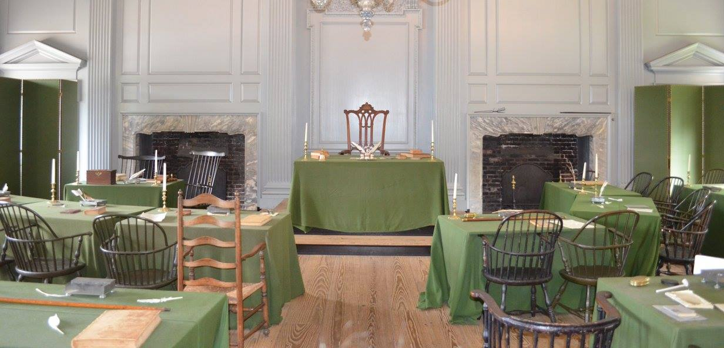

Slide 5
Constitutional Compromises
Many of the delegates disagreed on how the United States government should be outlined
Some wanted a king, some wanted no central government, some wanted bigger states to have power over smaller states
Debates over representation led to compromises

Slide 6
What is “Representation?”
A representative speaks/acts on behalf of a group of people
In the United States, we elect representatives to make laws and run the government
The Framers of the Constitution wanted to make sure the population in the United States was represented fairly, unlike when they were still part of England
Each class at Germantown gets to send 1 representative to decide policies for the school
Each class at Germantown gets to send 1 representative per 5 students to determine policies for the school

Slide 7
The Great Compromise
The Great Compromise was a blending of the Virginia and New Jersey Plans
It created a system of government with three separate branches to prevent any single branch from becoming too powerful
Legislative – Congress (makes laws)
Executive – President (enforces laws)
Judicial – Supreme Court (interprets laws)
It created a bicameral Congress in the Legislative branch
House of Representatives – States with higher populations have more representatives
Senate – Every state has 2 representatives, regardless of population

Slide 9
Think About It…
Why wouldn’t small states want representation in Congress to be based on population?
If representation was based on population, small states would have almost no power in the new government
Why wouldn’t big states want every state to be equally represented in Congress?
If every state was represented equally, the smaller populations in small states would have just as much power as the big states

Slide 10
The 3/5 Compromise
There was debate over whether slaves should be counted in the population of a state when determining representation in Congress
The South wanted slaves to count – this would give them higher populations and more representation
The North did not want slaves to count – this would give them lower populations compared to southern states and less representation

Slide 11
The 3/5 Compromise
The 3/5 Compromise counted each slave as 3/5 a person for determining representation – this helped maintain a balance of power between the northern and southern states

Slide 12
Federalism
Federalism is the division of power between a central/national government and smaller state governments
This idea separates power to prevent a central government from getting too powerful
Washington D.C. is the central/national government in the United States that the entire country must listen to
Each state also has its own government

Slide 13
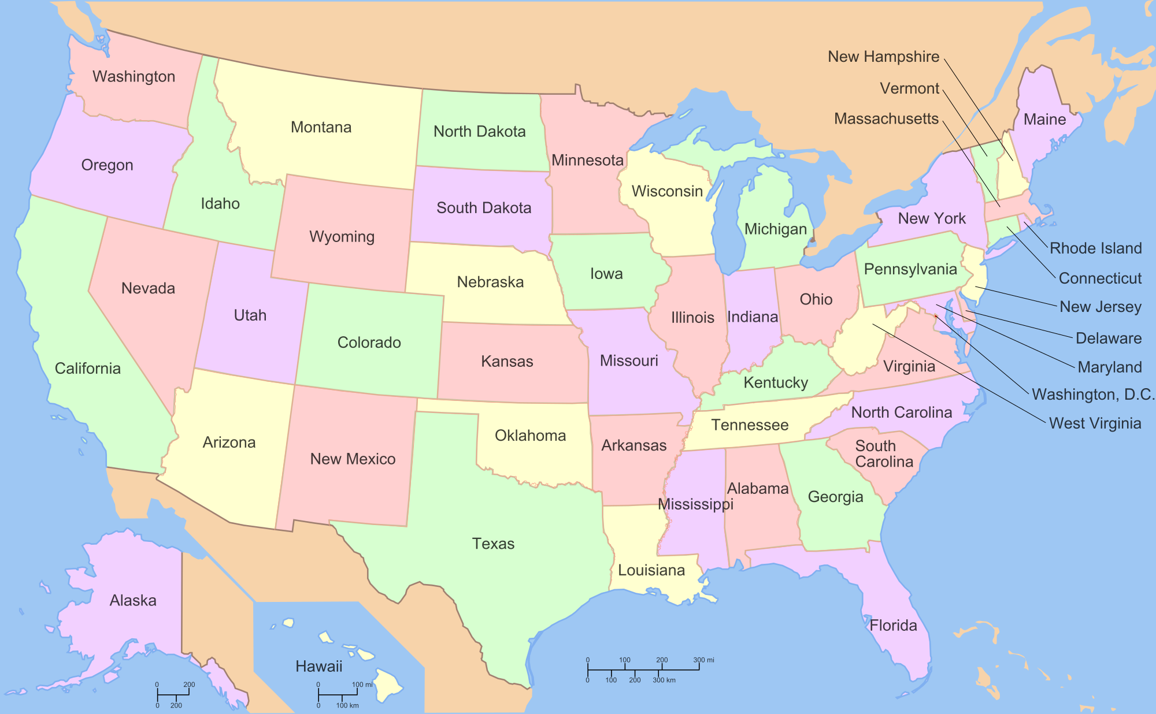
Central National Government

Slide 14
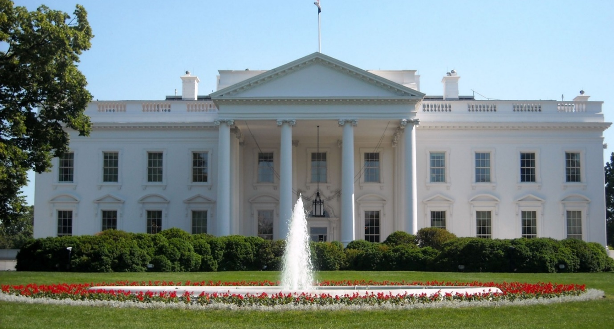
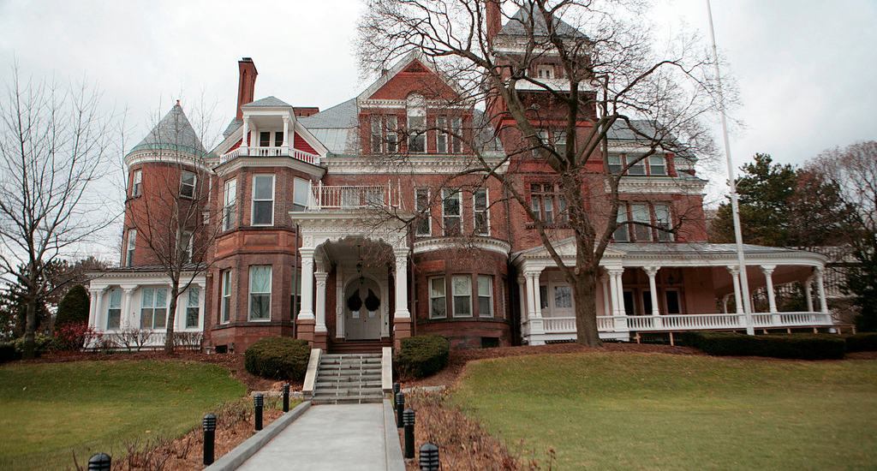
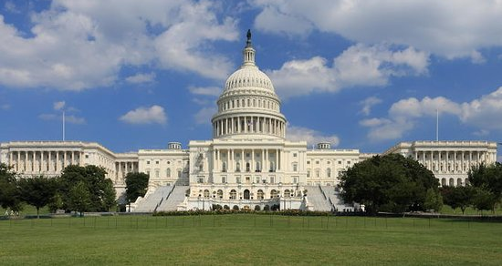
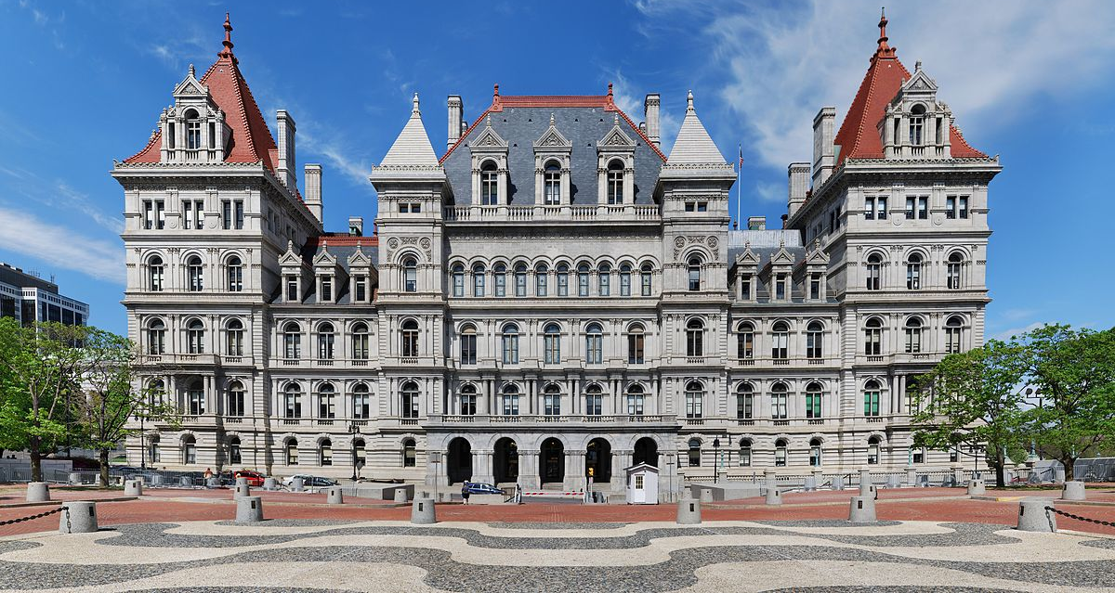

Slide 15
Federalism
Certain powers are reserved to the states – education, Driver’s Licenses, sales taxes, etc.
Sometimes, states challenge the power of the national government when they think it is overstepping its authority
You must follow the laws passed by both the national government (Washington D.C.) and the state in which you live (New York)

Slide 16
