Slide 1
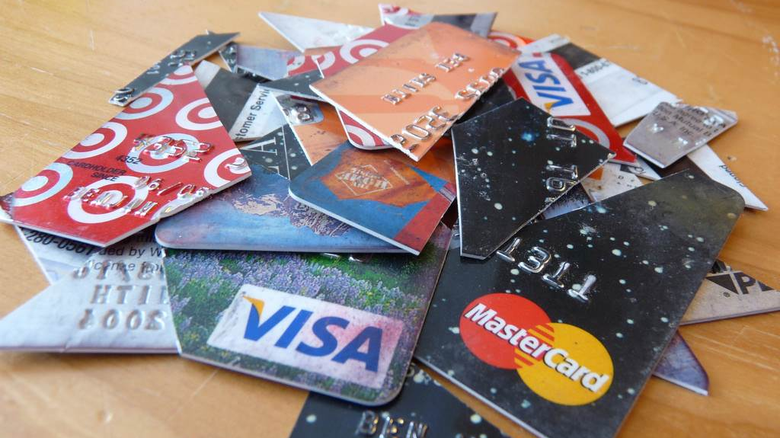
Credit Card Fees

Slide 2
Credit Card Interest Rates
Annual Percentage Rate (APR)
Cash Advance Interest Rate
The card’s interest charge, expressed as a yearly rate
Example: 24% APR means you pay an interest rate of 2% per month
The interest rate applies to purchases
The card’s interest charge for cash advances
A cash advance means you can charge the card and receive physical cash
Most cards charge a higher interest rate for cash advances than for purchases

Slide 3
How to Calculate Credit Card Interest
https://www.youtube.com/watch?v=6KWEca6QVoc

Slide 4
Credit Card Fees
Annual Fee
Application Fee
A fee charged for the mere “privilege” of having the card
Sometimes an annual fee will apply if you don’t use the card for at least a few charges during the year
A fee charged to open an account
Account opening fees cannot exceed 25% of the initial credit limit

Slide 5
Credit Card Fees
Transfer Balance Fee
Cash Advance Fee
Charge for transferring the balance from one credit card
Charged for cash advances
Usually charged as a percentage of the cash advance (example: 3%)

Slide 6
Credit Card Fees
Late Fee
Over-Limit Fee
Fee charged if your payment is late
Your due date is the same day each month
You must at least “post” a payment by the due date
Use auto pay to avoid late fees
Fee charged for going over your credit limit
The over-limit fee will continue to be charged every billing cycle when the balance owed exceeds the credit limit

Slide 7
Pay Your Entire Balance Every Month!
Do NOT carry a credit card balance from month to month
Paying off your entire balance is the ONLY way to avoid paying interest
Paying interest = throwing money in the trash!
Only use a credit card to purchase something you could write a check for in the same moment

Slide 8
THE BEST WAY TO BUILD YOUR CREDIT SCORE IS TO OPEN 1 CREDIT CARD, DESIGNATE ONE USE FOR IT, AND PAY IT OFF IMMEDIATELY AFTER YOU USE IT

Slide 9
Why Even Bother Having a Credit Card?
Builds your credit score
You can earn “rewards” – cashback, free air travel, discounts, etc.
In case of emergency – debit card doesn’t work or is lost

Slide 10
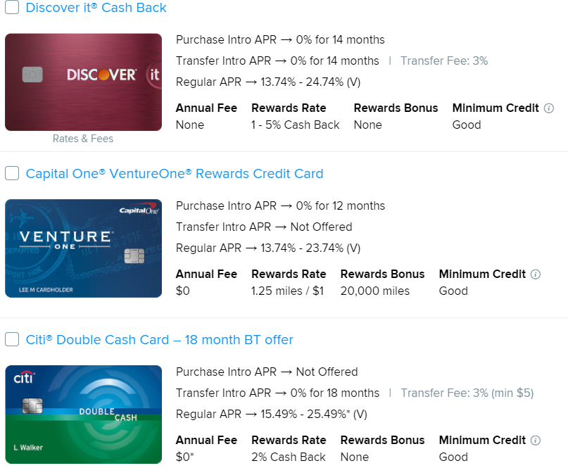
Credit Card Rewards

Slide 11
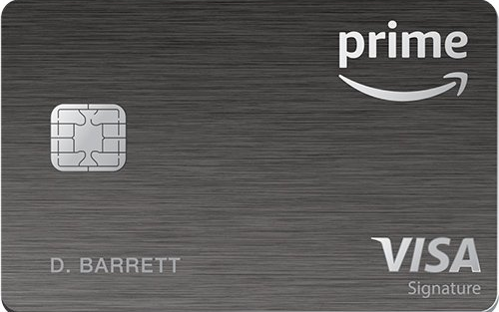

Slide 12
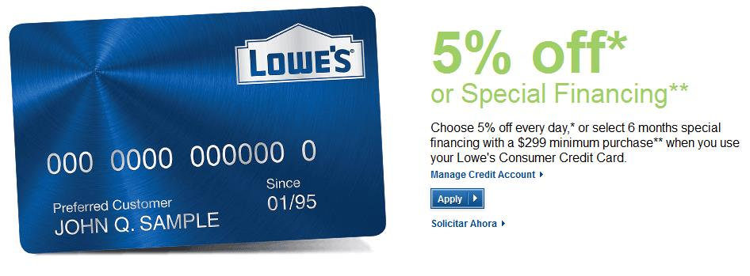
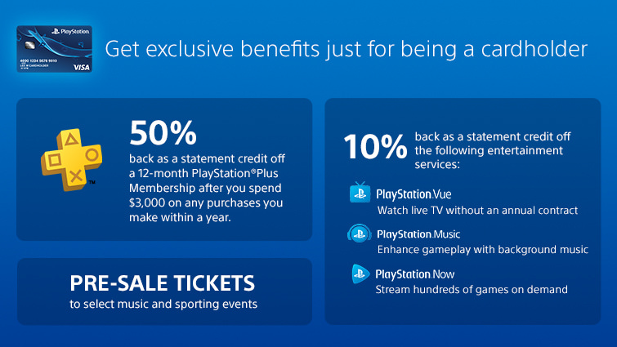

Slide 13
