Slide 1
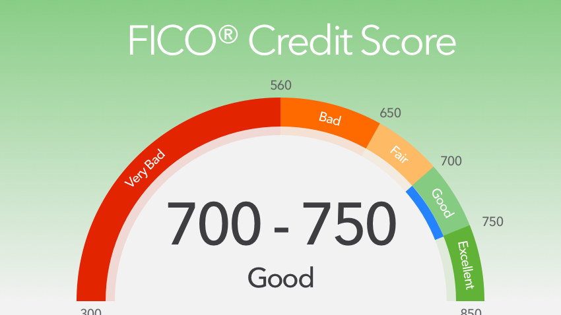

Slide 2
FICO/CREDIT SCORES
Defined – a calculated measurement to represent your creditworthiness
The score influences several aspects of your financial identity – particularly your ability to borrow
Calculated by the 3 credit bureaus - TransUnion, Experian, and Equifax
Found on your credit report
FICO Score Range between 300 & 850
U.S. average: 723
< 620 = higher rates
> 760 = best rates
Consumers should carefully review their credit reports yearly and contest any discrepancies

Slide 3
The Credit Catch-22…
How do you establish credit when you have no credit?

Slide 4
Why is Credit Important?
FICO or credit scores influence several aspects of your financial identity and status.
Credit Card Issuers & Loan Lenders
Determine interest rates
Auto Insurers
Determine Premium
Employers
Are you a worthy hire?
Landlords
Are you a reliable tenant?

Slide 5
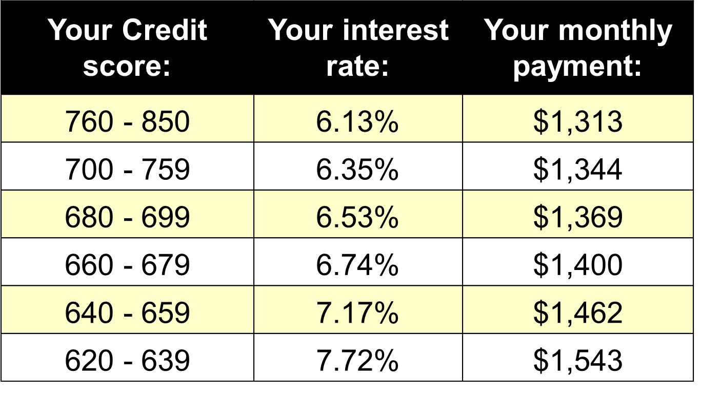
The Cost of Borrowing $216,000 30-year, fixed rate mortgage

Slide 6
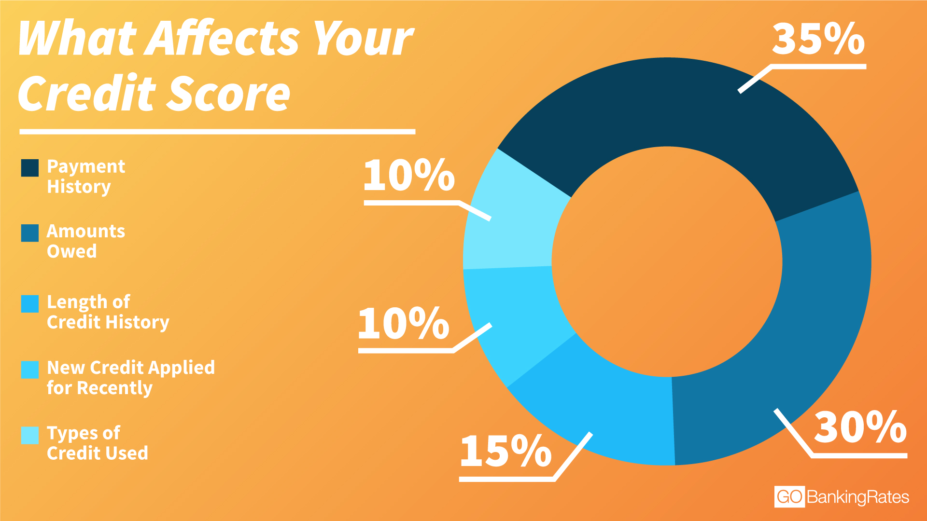

Slide 7
35% - Payment History
Payment History factors include:
Recent payments
Frequency of payments
Payments made in full
Minimum payments
On-time payments have the greatest positive impact.
Late payments have the greatest negative impact.

Slide 8
30% - Amount Owed
Amount Owed factors include:
How much in total is owed
How many lines of credit are extended
How long have you owed
How much more could you borrow
The greatest impact is the comparison of an individuals Total balance vs. total available credit.

Slide 9
15% - Length of Credit History
Length of Credit History factors include:
Number of years you’ve used credit.
How long have you had used certain accounts.
How long since you’ve used certain accounts.
Did you cancel your accounts
Did the lender cancel your account

Slide 10
10% - New Credit
New Credit factors include:
Number of new accounts
Number of credit inquiries
Frequency of credit inquires
Multiple requests reduce your credit score.

Slide 11
10% - Types of Credit
Types of Credit factors include:
Revolving Credit
Credit cards
Installment Credit
Car loan
Home loan
Student loan
Revolving credit has a greater negative impact.
Installment credit has a greater positive impact.

Slide 12
How to Improve Your Score
Pay all credit card bills and loan payments on time.
Pay any delinquent bills.
Lower your total credit card debt.
Pay balances in full.
Don’t close unused credit cards.
Don’t open up new credit cards to increase available credit.
Avoid “instant credit” inquires.

Slide 13
Credit/FICO Score: Writing Task
Using what you have learned, write a well-developed paragraph response to the following task:
Describe the different factors that are considered when calculating your credit/FICO score.
Explain how to improve your credit/FICO score and why having a high score is ideal for a borrow.

