Slide 1
Do Now
As an entire class, come up with at least 3 things you want changed about this class
These 3 things can be related to anything (classroom setup, homework, notetaking, classwork, etc.)
You must come up with the 3 things as a group – however you choose to organize is up to you – after you have agreed, you will present your ideas to me
You have 8 minutes

Slide 2
Fighting for Better Working Conditions
How did workers try to achieve better conditions?

Slide 3
Workers Form Labor Unions
A labor union is an organized group of workers that work together to protect their rights and further their interests
In response to the poor working conditions of the time (long hours, low wages, dangerous machinery, unsanitary factories), workers formed unions
Workers hoped that by forming unions, they could convince businessowners to increase pay, decrease the length of the workday, and provide better conditions overall for people working in their factories
Unions could be local (just the workers in a certain factory), national (workers across the nation in a specific field of work), or both

Slide 4
The Teacher’s Union
National Education Association (NEA) & American Federation of Teachers (AFT)
National
Deals with large-scale issues facing teachers and public schools across the United States
National funding for public education
School security
Teacher federal student loan forgiveness
New York State United Teachers (NYSUT)
State
Deals with issues facing all New York state public schools
Teacher evaluations
“Seat time”
Safety drills
Germantown Teachers Association (GSA)
Local
Deals with local issues facing Germantown Central School District
Wages
Sick time
Teacher schedules

Slide 5
Two Major Labor Unions During the Gilded Age
Knights of Labor
American Federation of Labor
Formed in Philadelphia in 1869
Goals:
8 hour work day
End child labor
Equal pay for equal work
Organize ALL working people (factory workers, shopkeepers, office workers, etc.)
Was mostly unsuccessful because membership was too broad (too many different types of workers)
Formed in 1886 by Samuel Gompers
Goals:
Increased wages
Better working conditions
Organize SKILLED workers only (craftsmen, machine operators, etc.)
Collective bargaining – workers as a group negotiate with their employer
Relatively unwelcoming to African Americans and women workers (saw them as competition for jobs)

Slide 6
Labor Unions and Immigration
Many national labor unions, including the Knights of Labor and the American Federation of Labor, opposed immigration
Why?
Workers feared that immigrants would
Flood the workforce and take job openings
Be more willing to work for less pay and in worse conditions
The Knights of Labor and American Federation of Labor both supported the Chinese Exclusion Act

Slide 7
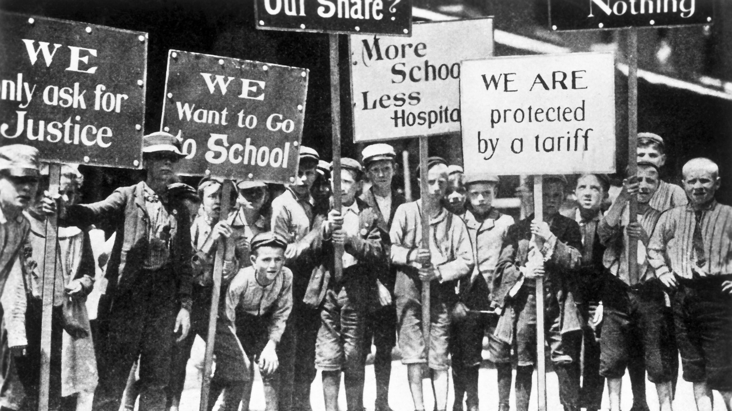
Labor Unions Used Strikes to Fight for Better Conditions

Slide 8
Big Business Responds
Employers feared labor unions
Why?
Businessowners did not want to pay higher wages and provide better working conditions because it would make them lose profits!
To weaken unions, employers:
Forbid union meetings
Fired union organizers
Forced employees to sign contracts saying they would not join a union
Refused to meet with union leaders or members to discuss conditions

Slide 9
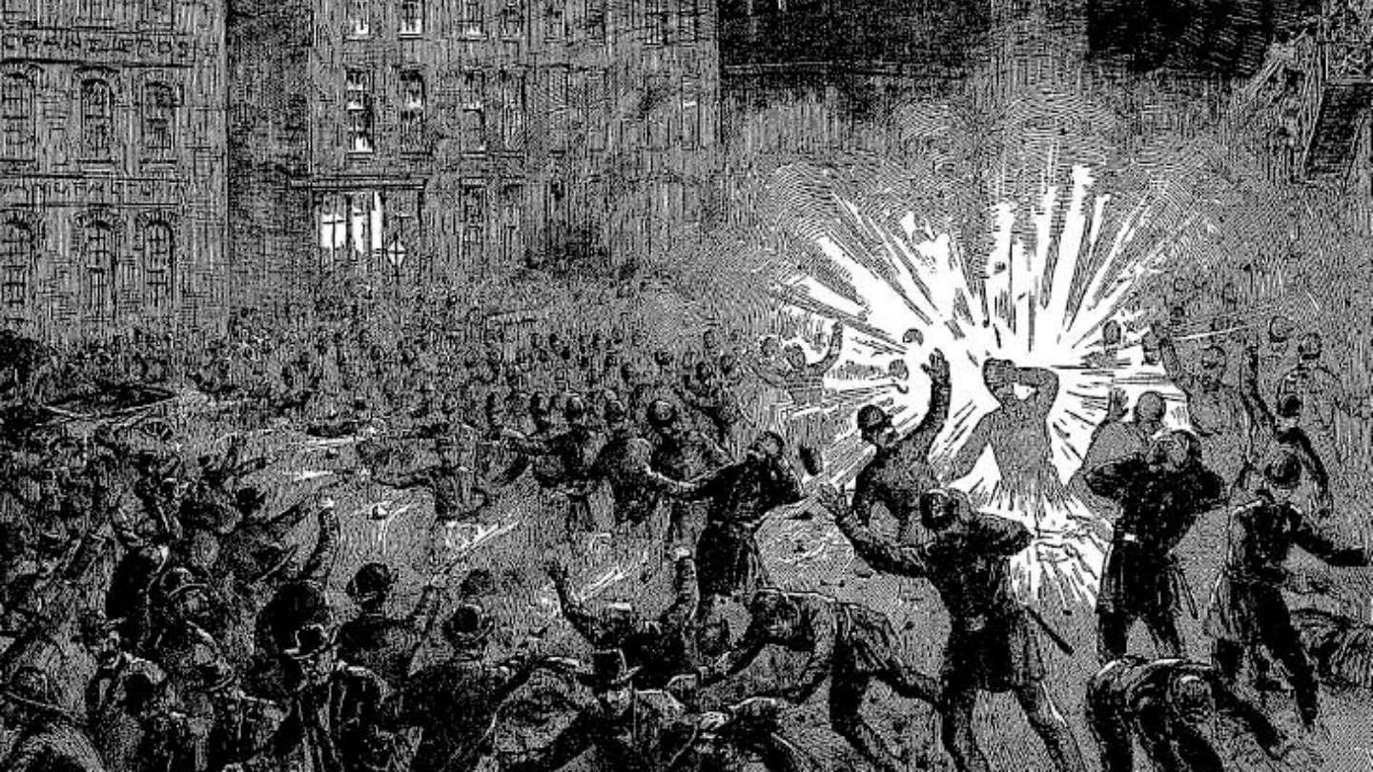
Sometimes, Clashes Between Unions and Businessowners Would Turn Violent

Slide 10
Some Workers Turn to Socialism
In the cities, many workers were facing poor working and living conditions
Because of the unequal distribution of wealth between the rich and the poor, some American workers adopted socialism
Socialism is an economic philosophy that supports the belief that workers should share in the profits of big business and opposes the private ownership of property
Many Americans (especially businessowners) opposed socialism because they saw it as a threat to their businesses and to the American values of private property and individual liberty

Slide 11
Farmers Form the Populist Movement
After the Civil War, farmers were upset because of
Deflation – crop prices were dropping
Tariffs – imported farming equipment was more expensive to buy
They formed the Populist Movement, which fought for
Progressive Income Tax – higher tax on the wealthy
Increased money supply to help raise crop prices
Government ownership of communication and transportation systems – they wanted government regulated railroad rates so they could afford to transport their crops

Slide 12
Pullman Strike Exit Ticket

