Slide 1
Good Morning!
Please take a note sheet from the front
You need your ipad today as well

Slide 2
Tool #2: Foreign Aid
When a state helps another state to improve relations and achieve their own foreign policy objectives
Two types of foreign aid:
Military
Economic

Slide 3
Military and Economic Aid
Military Aid
States donate, sell, or trade military equipment and technology to affect the military balance of power in regions of the world
Military alliances are agreements between nations with the promise of mutual defense – if one nation gets attacked, the other will come to its defense
Economic Aid
States donate or loan money to other countries in order to boost economic development

Slide 4
Examples of Military Aid
North Atlantic Treaty Organization (NATO) is a military alliance between many nations in North American and Europe
The United States has provided Israel nearly $127 billion in military aid
During the Iraq War, countries like the United Kingdom, Australia, and Poland supported the United States’ invasion efforts
Military alliances contributed to the start of World War I – when Austria-Hungary declared war on Serbia, military allies on each side rushed to support their allies
Russia, Serbia’s ally, declared war on Austria-Hungary
Germany, Austria-Hungary’s ally, declared war on Russia
Germany declared war on France, fearing it would support Russia
Great Britain, France’s ally, declared war on Germany

Slide 5
Examples of Economic Aid
United States contributed $16.3 billion in development assistance for other countries in 2003
After World War II, the U.S. Marshall Plan helped western Europe recover from the war – the U.S. gave nearly $140 billion
U.S. Agency for International Development (USAID) gives food assistance in over 150 countries to over 3 billion people

Slide 6
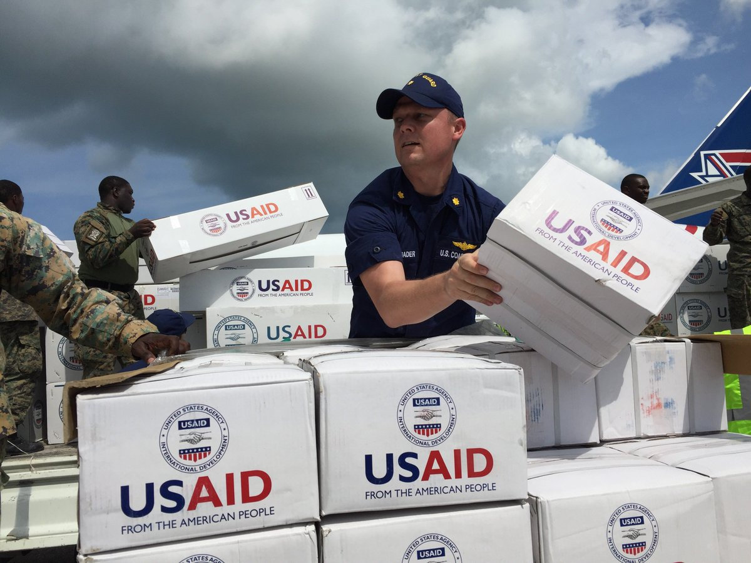
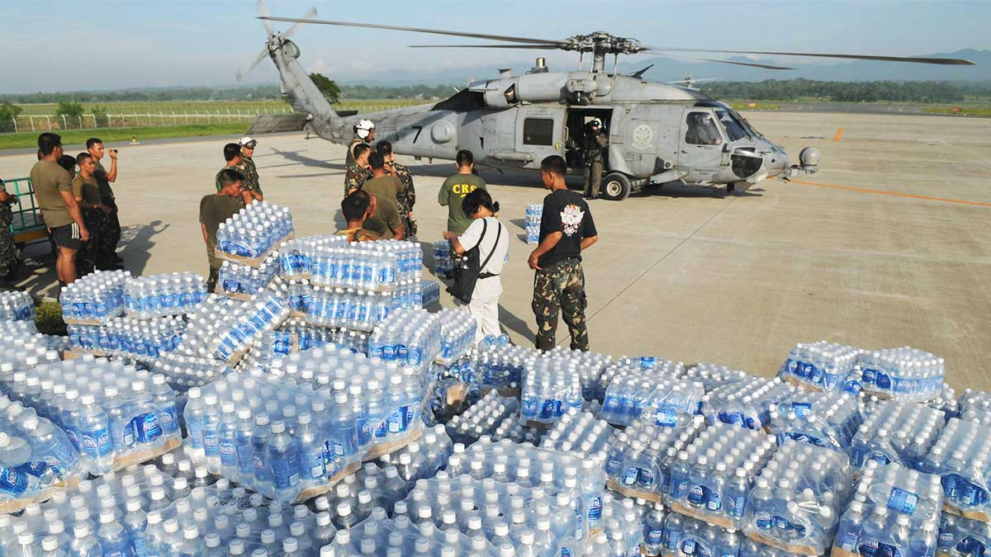

Slide 7
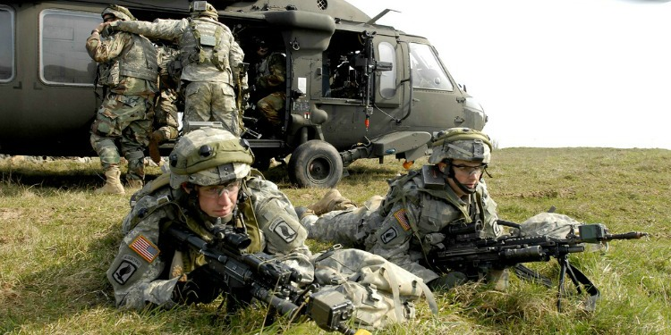
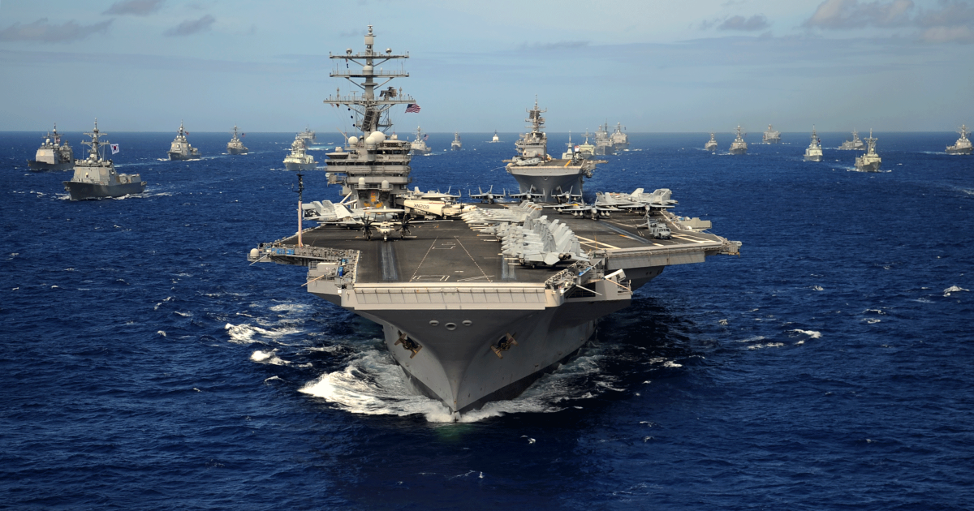
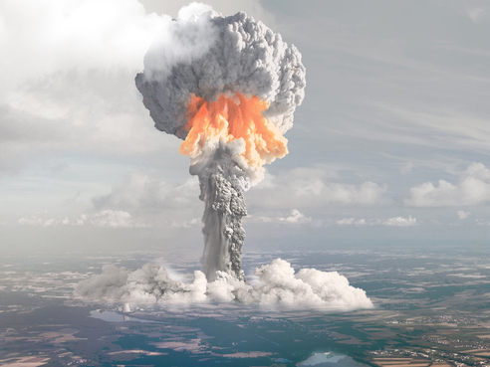
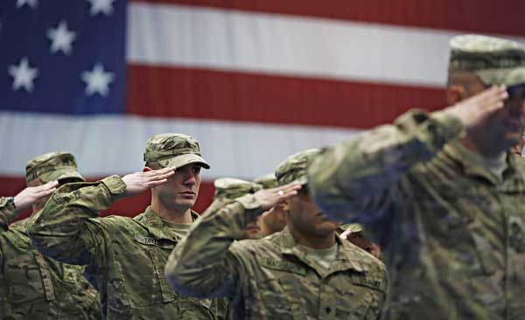
Tool #3: Military Force

Slide 8
Tool #3: Military Force
States use military force or the threat of military force to achieve their foreign policy objectives
Stronger states pressure weaker states
Countries like Nazi Germany used warfare to conquer and expand territory
Deterrence: Countries build up their militaries to deter other countries from attacking them
During the Cold War, the U.S. and the Soviet Union both built up their nuclear weapons arsenal to deter each other from ever using them (mutually assured destruction)

