Slide 1
DO NOW
Please take and complete the survey from the front of the room

Slide 2
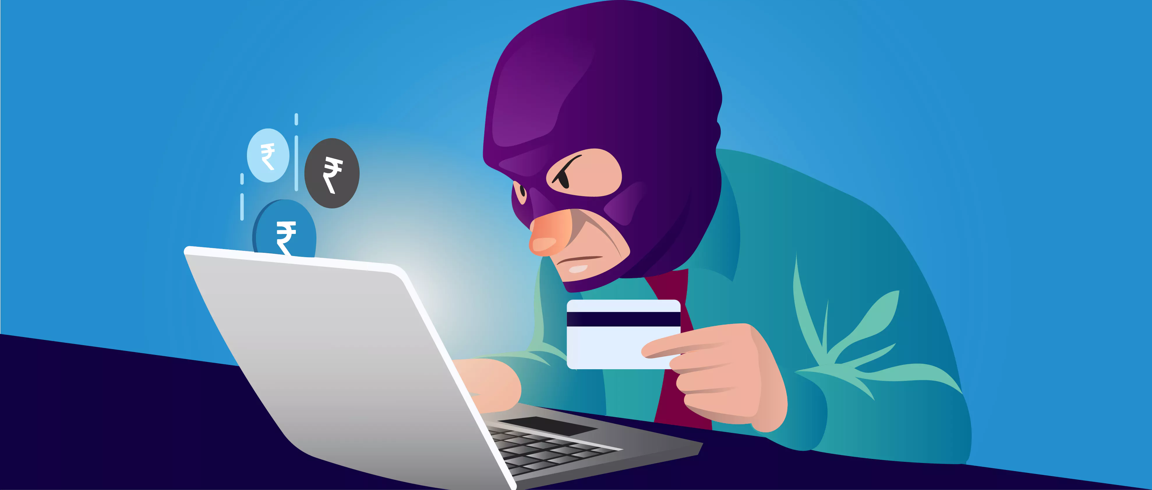

Slide 3
Learning Objectives
What is "Identity Theft?"
1
How can you make sure you don't become a victim of identity theft?
2
What should you do if your identity has been stolen?
3

Slide 4
What is identity theft?
Identity theft is when someone pretends to be YOU!
The thief's goal is to gain access to your financial resources (bank accounts, credit cards, etc.)
Some thieves even plan to open new credit cards in YOUR NAME
Identity theft is a Federal and State crime (so don't get any ideas)
If you're a victim of identity theft, it can take years to recover
Unfortunately, it's your responsibility to fix all of the damage caused by the thief

Slide 5
Guard these with your life
Your wallet (Driver's License, Debit Card, Credit Card)
Social Security Number
Banking Information
Log-in IDs/Passwords
Mother's Maiden Name

Slide 6
Are you being careful enough?

Slide 7
Warning signs of identity theft
Purchases on your bank account statement you didn't make
Purchases on your credit card you didn't make
Communication concerning a new account you didn't open
Missing mail
Regular bills are not delivered

Slide 8
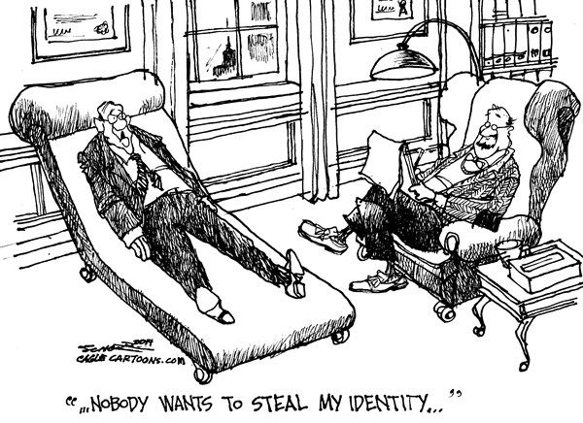

Slide 9
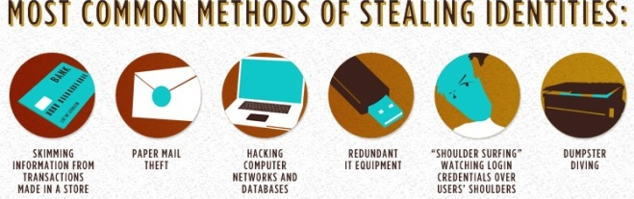
How does the thief get your information?

Slide 10
Financial Identity Records that can help a thief
Social Security Number
Birthdate
Physical/Mailing Address
Driver's License ID Number
Bank Statements
Loan Information
Pay Stubs
Passport
College Transcripts
Tax Returns
Bank Checks
Receipts

Slide 11
What Can I do to protect myself?!
Check your bank and credit card statements often!!!
1
Use online banking
2
Protect your online usernames & passwords
3
Be aware of your surroundings – check the ATM
4
Check your credit report
5
Don't give anyone your information if you can't confirm their identity
6
Shred important documents when you get rid of them
7

Slide 12
What Do I do if my identity gets stolen?
Place an initial fraud alert on your credit report
Notify active accounts that you are a victim of identity theft – call your bank!
File an identity theft report with the Federal Trade Commission & local police
Lawyer up!

Slide 13
Learning Objectives
Why are children particularly vulnerable to identity theft?
Why is social media a valuable tool for committing identity theft?

Slide 14
Child Identity Theft: "1 in 10"

Slide 15
Child Identity Theft News Report

Slide 16
Identity Theft: Social Media

Slide 17
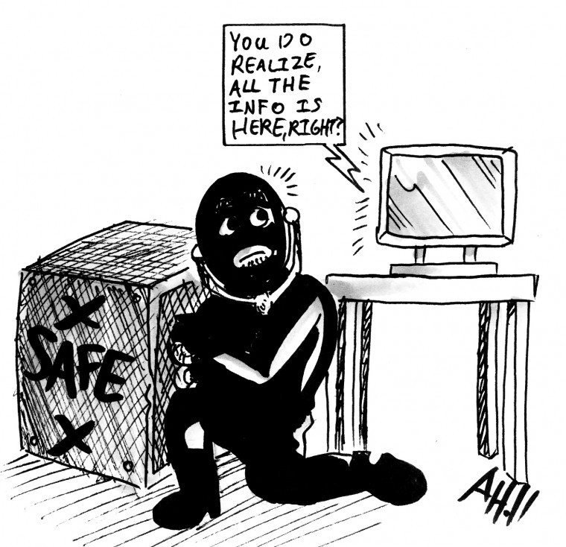

Slide 18
Staying organized
The Best Way to Combat Identity Theft

