Slide 1
Do Now
Read and annotate the primary source reading on working in a factory during the Gilded Age. Then, respond to the questions that follow

Slide 2
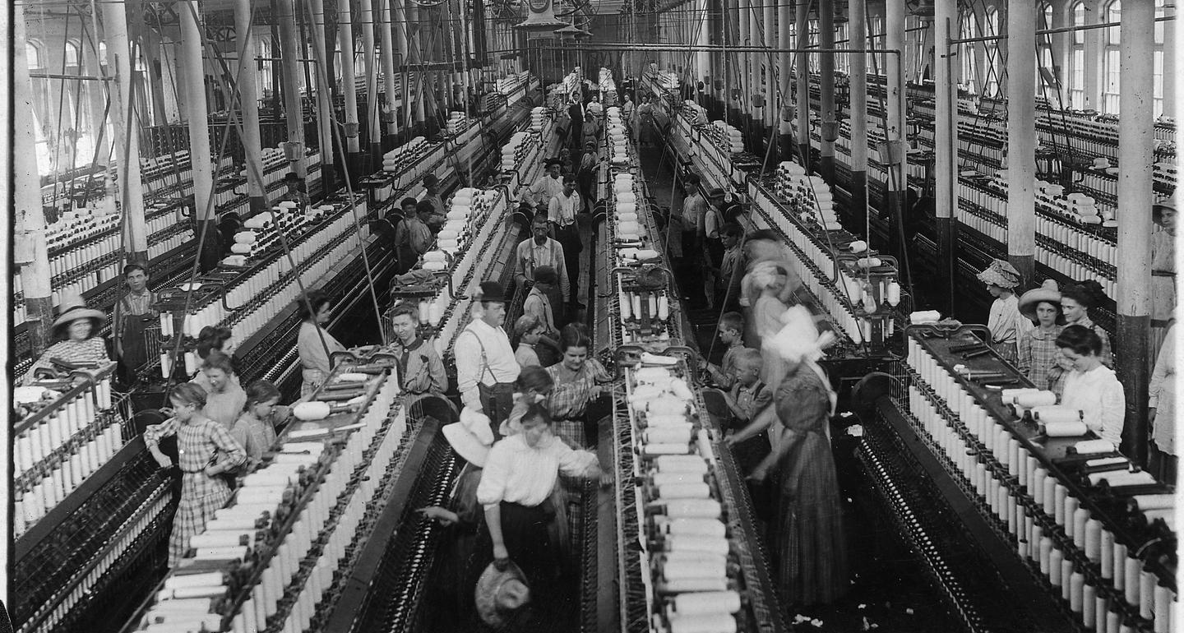
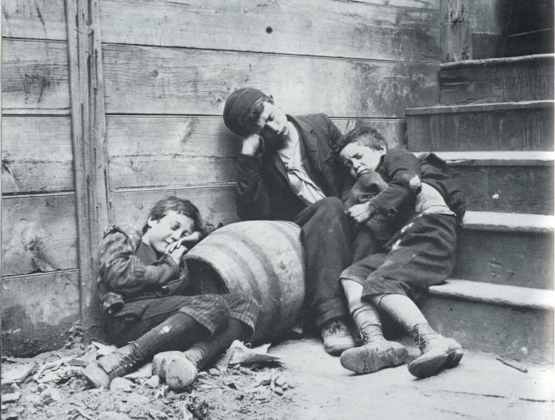

Slide 3
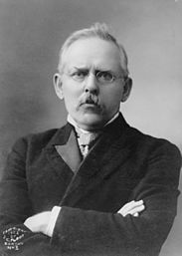
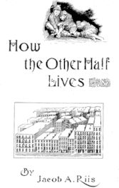
How Do We Know About the Problems Society Faced During the Gilded Age?

Slide 4
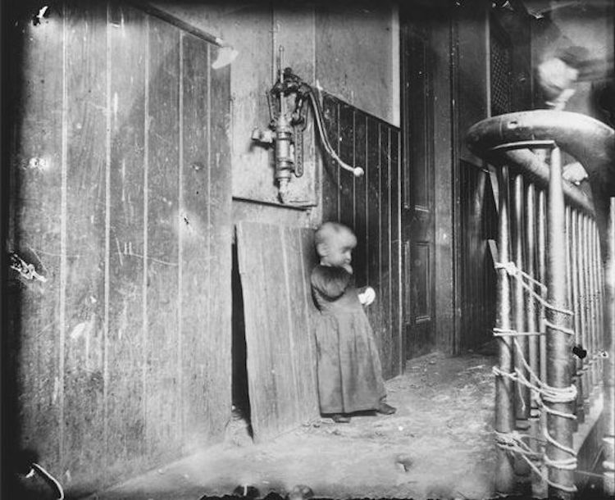
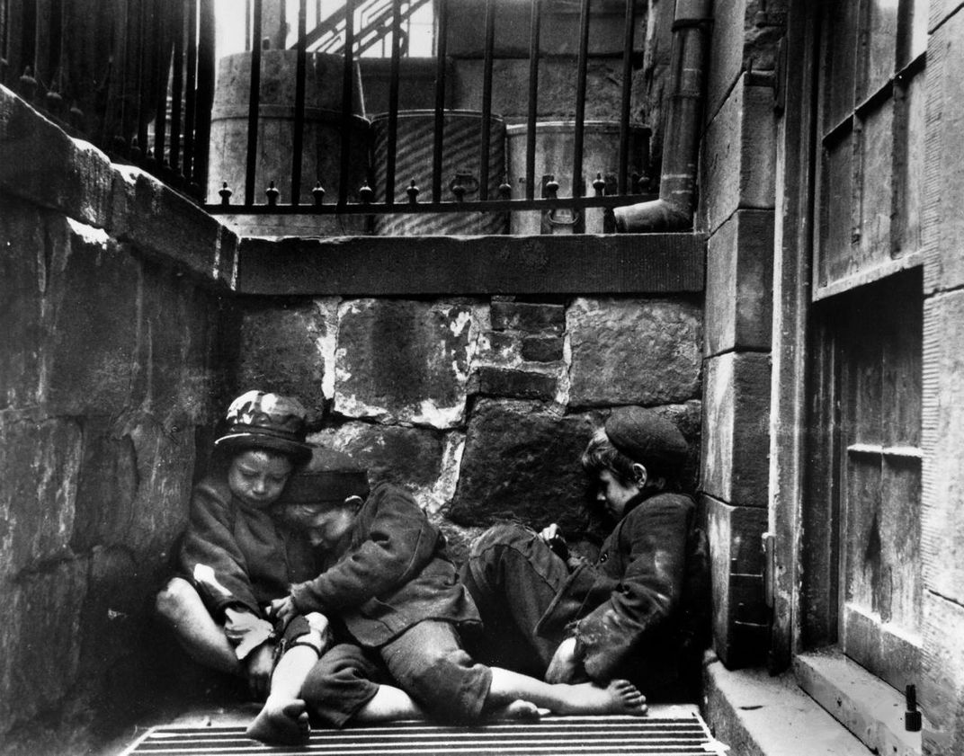
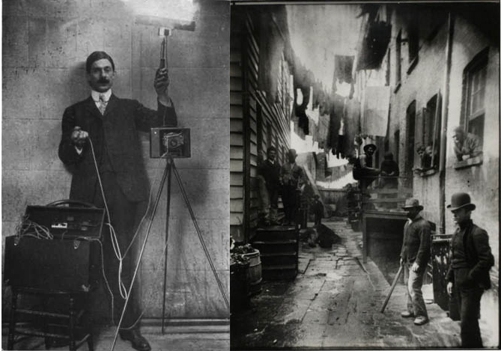
Jacob Riis’ How the Other Half Lives
How Did We Get To This Point?

Slide 5
Immigration
Between 1885-1920, around 21 million immigrants came to the U.S.
Many left their homes because of famine, persecution, etc. (push factors), and came to the U.S. looking for jobs and opportunity (pull factors)
“Old Immigrants” arrived between 1865-1890 and came from Northwest & Central Europe
These immigrants were mostly white, Protestant, and English-speaking
“New Immigrants” arrived between 1890-1920 and came from Eastern Europe, Asia, & the Middle East
These immigrants were diverse in their religions, cultures, languages, and customs

Slide 6
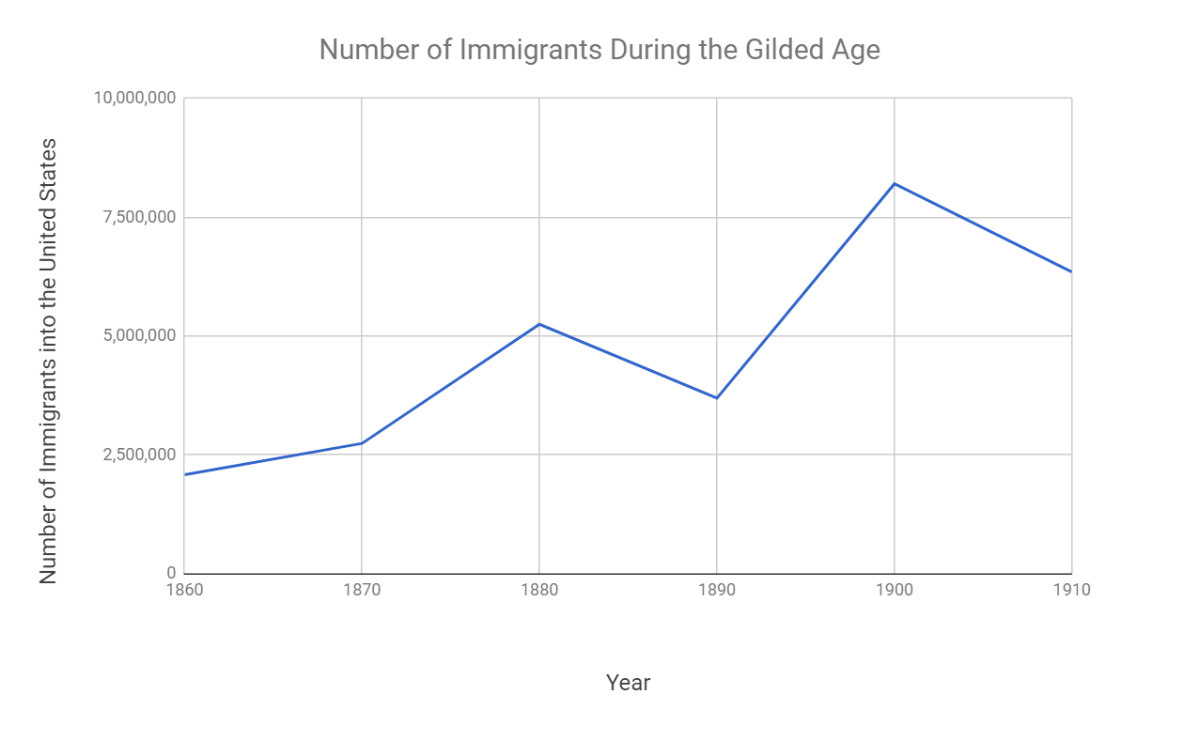

Slide 7
Increased Immigration Led to Increased Nativism & Anti-Immigration Laws
Nativists were people born in the U.S. that opposed immigration
Many immigrants, especially “new immigrants,” faced racism, hostility, and segregation
The Gentlemen’s Agreement (1908) limited the number of immigrants from Japan
The Chinese Exclusion Act (1882) limited the number of Chinese laborers for 20 years
This was a response to the number of Chinese that came to California and worked on the Transcontinental Railroad

Slide 8
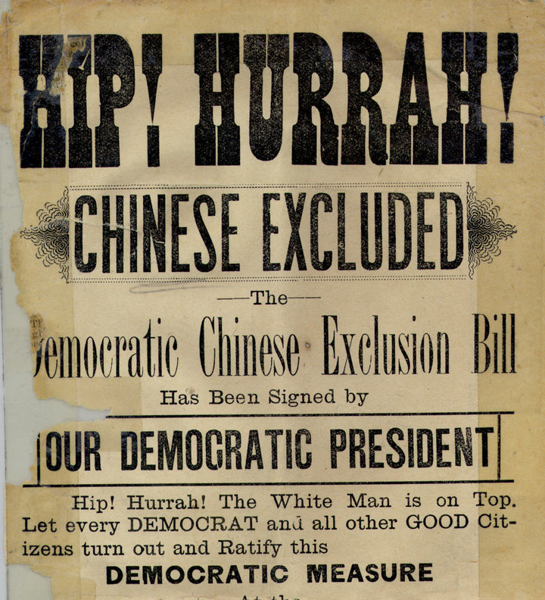
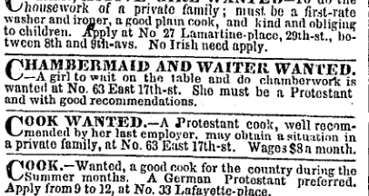

Slide 9
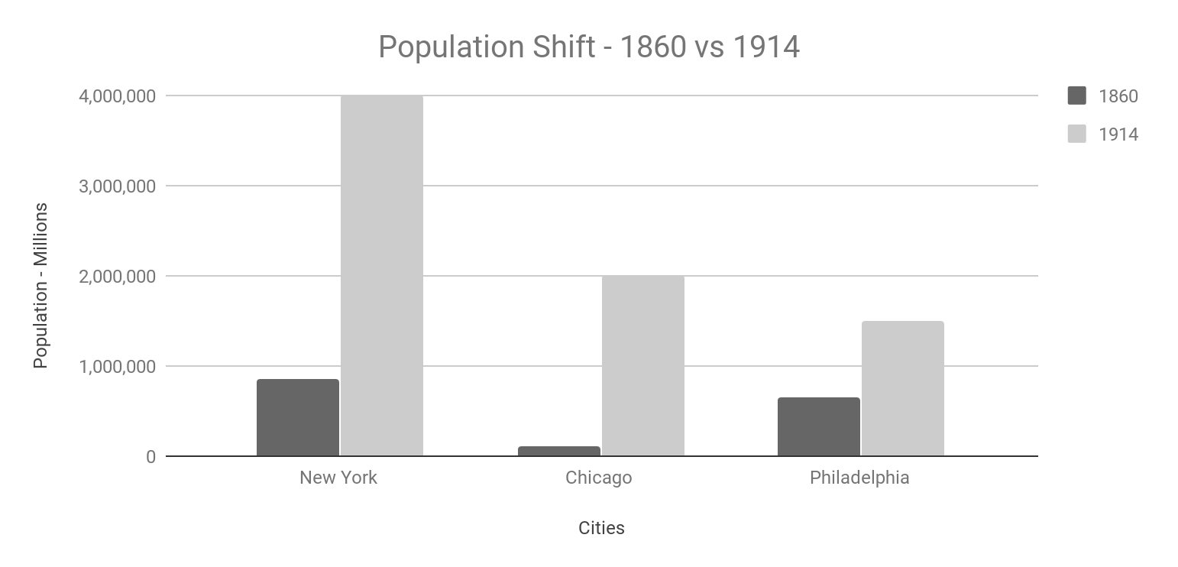

Slide 10
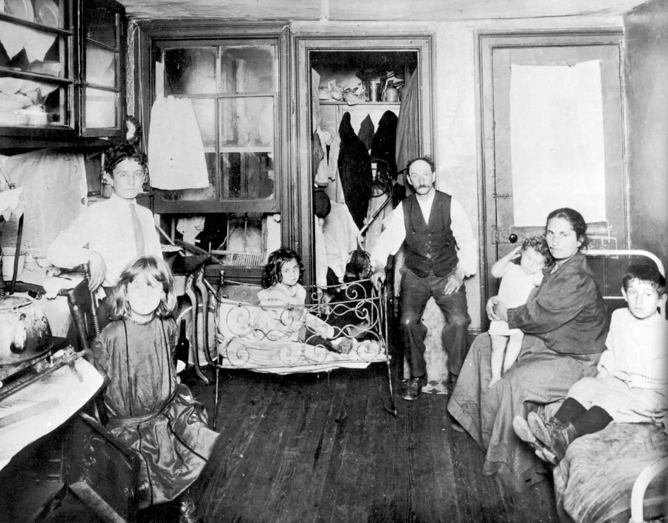
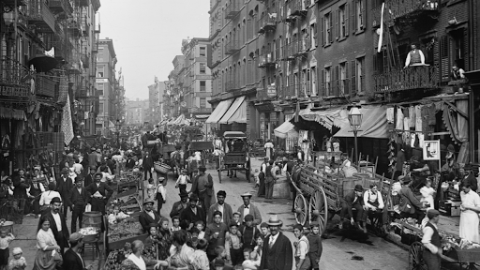
Urbanization (The Growth of Cities)
Most immigrants settled in U.S. cities (that’s where the jobs were located)
They lived in tenements: crowded apartment buildings with poor ventilation, disease, filth, and high death rates

Slide 11
Effects of Urbanization
Increased economic gap between the rich and the poor
The middle class and wealthy moved to the suburbs (areas outside the cities) while the poor lived in the crowded, dirty city centers
Disease, poor sanitation, and overcrowding plagued urban areas
Political corruption resulted from “political machines” and “political bosses” who gave poor immigrants jobs and favors in return for votes
Boss Tweed became the most notorious political boss in NYC after stealing millions of dollars from city taxpayers

Slide 12
The Politics of Big Business
The U.S. government did not regulate businesses or the economy
The government followed a policy of “laissez-faire” (hands-off) when dealing with the economy
The belief was that good businesses would naturally succeed through the free market
The government did pass some limited regulations:
Interstate Commerce Commission (1887) to regulate railroad rates
Sherman Antitrust Act (1890) to try to prevent the creation of monopolies
However, government corruption often allowed businesses to avoid regulations

Slide 13
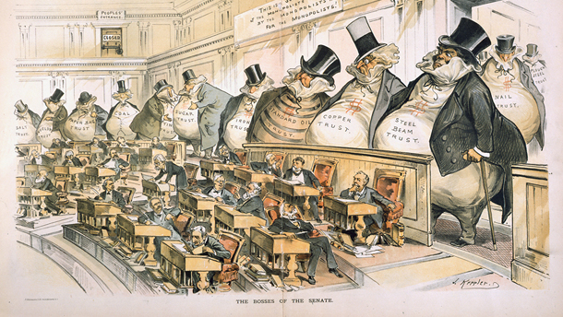

Slide 14
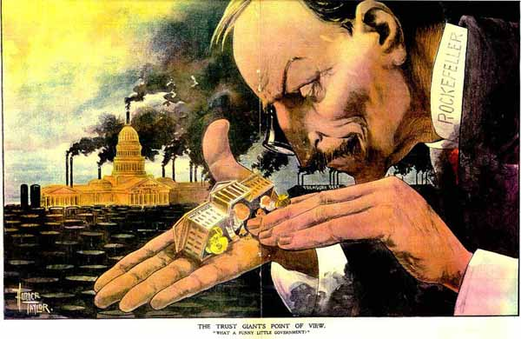

Slide 15
Working Conditions During the Gilded Age
Due to limited regulations, working conditions during the Gilded Age were often poor and even dangerous
Workers often worked 10-12 hour days, 6 days a week
Children often worked with dangerous machinery
Doors were often locked to prevent workers from taking breaks – 146 workers died in the Triangle Shirtwaist Factory Fire
Division of labor: factory workers performed the same small task all day and never saw the finished product of their work
Owners of big businesses rarely interacted with their workers

Slide 16
Social Darwinism
Darwinism: The scientific theory that focuses on “survival of the fittest” and natural selection as the mechanism for evolution
Social Darwinism: The application of survival of the fittest to society
Those who acquire wealth are the most “fit;” those who remain poor are “unfit” and are lazy or incapable
Big business owners argued that government should not regulate the economy so as not to upset natural selection

Slide 17
Industrialization, Urbanization, increased populations due to immigration, and no regulation of business all contributed to the poor living and working conditions of lower class Americans

