Slide 1
The Monroe Doctrine
Should the USA play a role in the rest of the world?

Slide 2
The War of 1812 Proved that the USA Was Strong Enough to Repel European Aggression

Slide 3
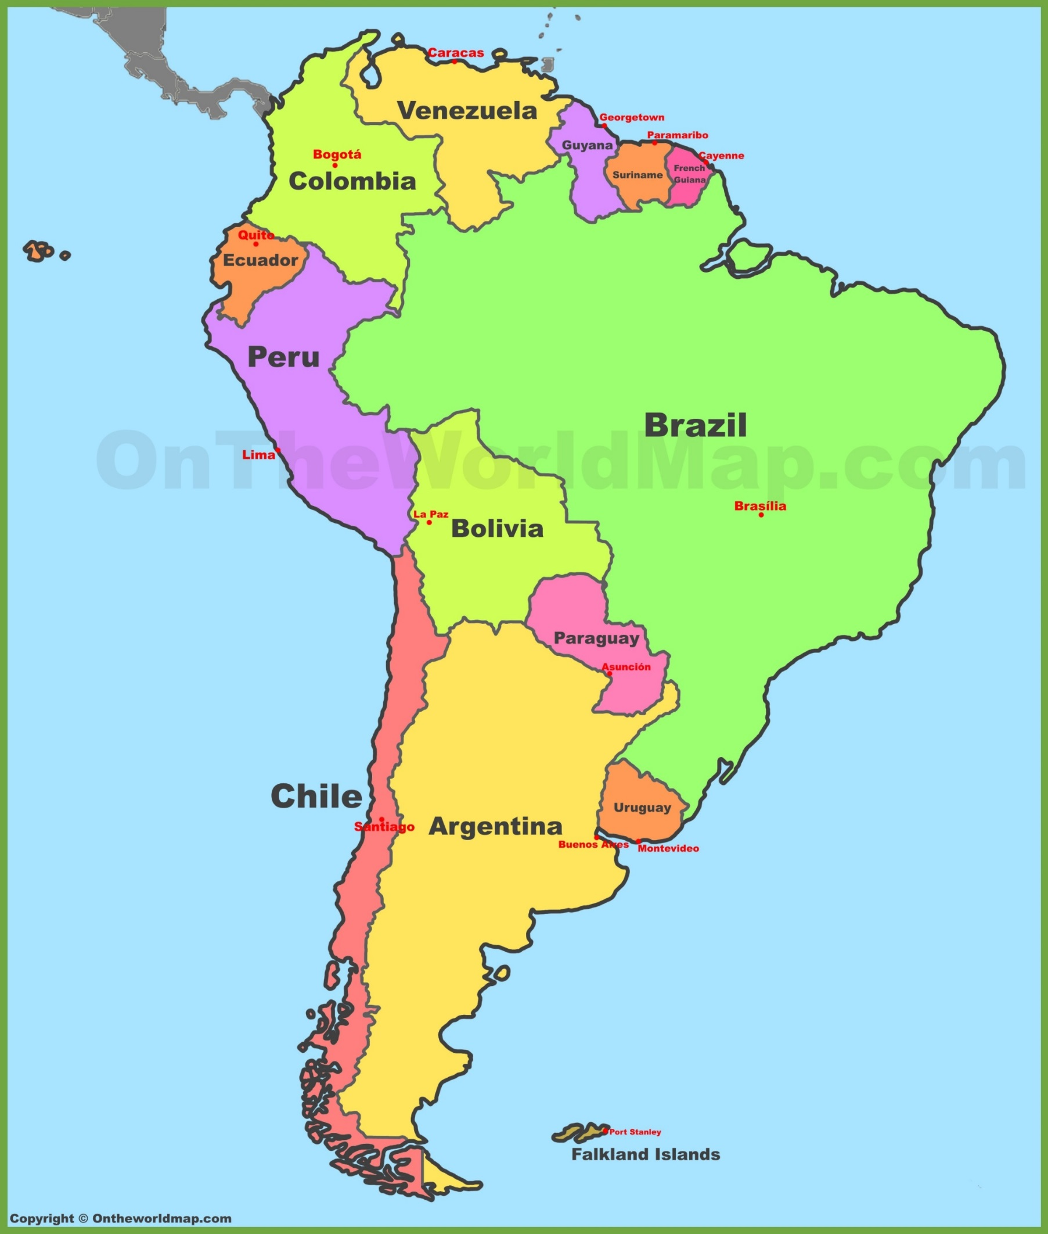
However, there was a place that was still vulnerable to European intervention and colonization

Slide 4
Europe could put military bases closer to the USA – war?!
South American countries could lose their independence
The USA would lose out on important alliances/resources in South America
What could happen to the United States if European powers colonize South America?

Slide 5
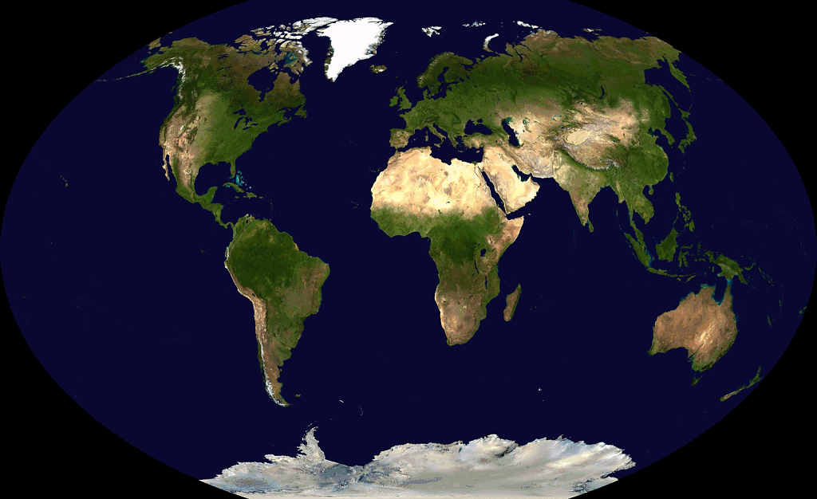
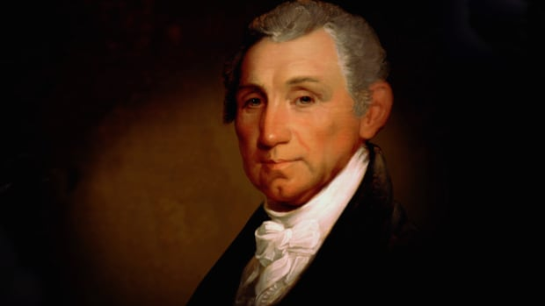
You best stay on your own side!
Western Hemisphere
Eastern Hemisphere

Slide 6
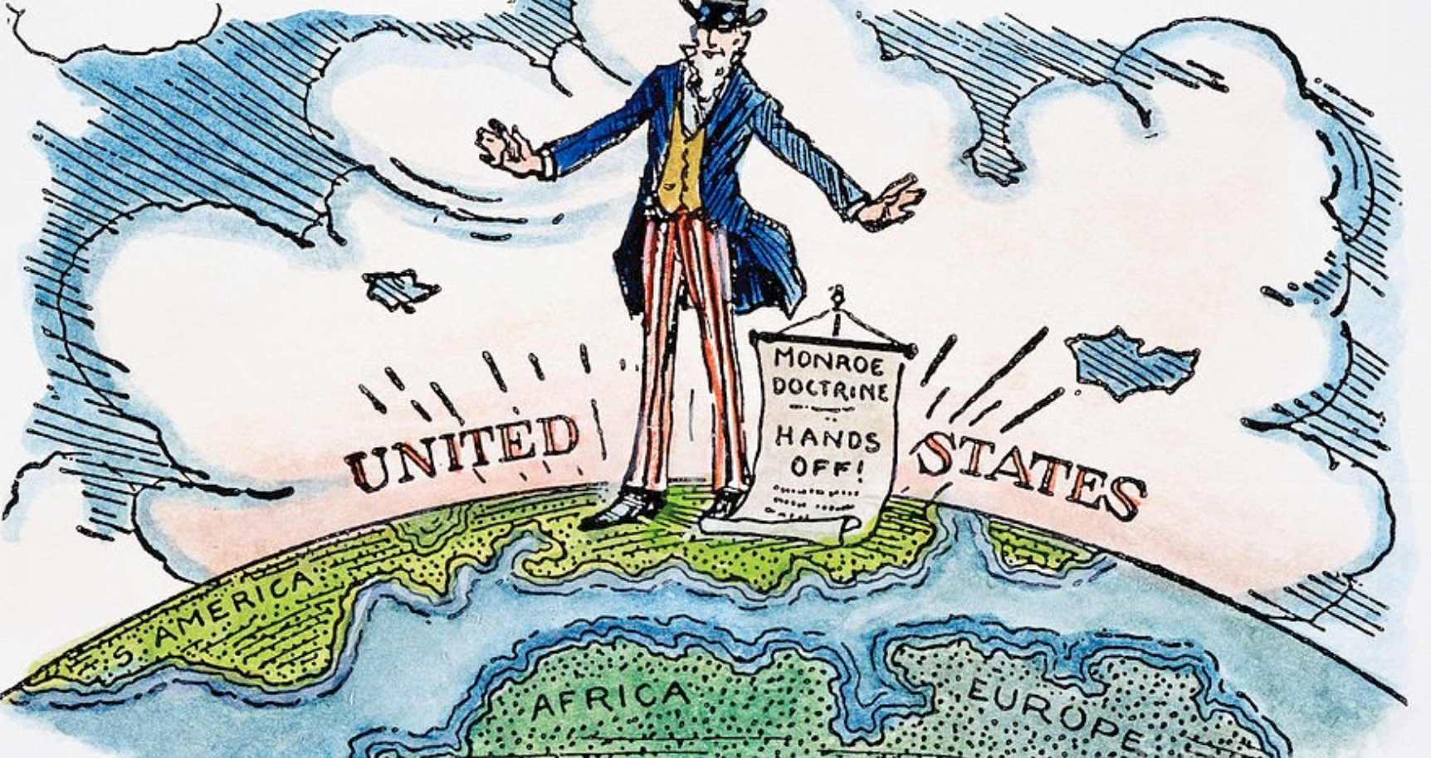

Slide 7
The Monroe Doctrine
https://www.youtube.com/watch?v=BDQWHfM17S8

Slide 8
The Monroe Doctrine
The United States did not want European nations colonizing the western hemisphere because:
Europeans would have a foothold near the United States
South American nations would lose their independence
The USA wanted to “protect democracy”
The USA wanted to build relationships with South American nations for economic and political benefits

Slide 9
The Monroe Doctrine Stated that:
The U.S. would not become involved in any internal European affairs
The U.S. recognized the European colonies that already existed in the western hemisphere
Any new European colonization in the western hemisphere would not be allowed
Any European attempt at colonization in the western hemisphere would be viewed as a hostile action against the United States

Slide 10
