Slide 1
Please Take Out Your Map Activity from Yesterday and Continue Working
YOU HAVE 15 MINUTES TO COMPLETE YOUR MAP
MAKE SURE IT IS NEAT – YOU WILL HAVE TO USE THIS OVER THE WEEKEND TO STUDY FOR YOUR QUIZ ON MONDAY

Slide 2
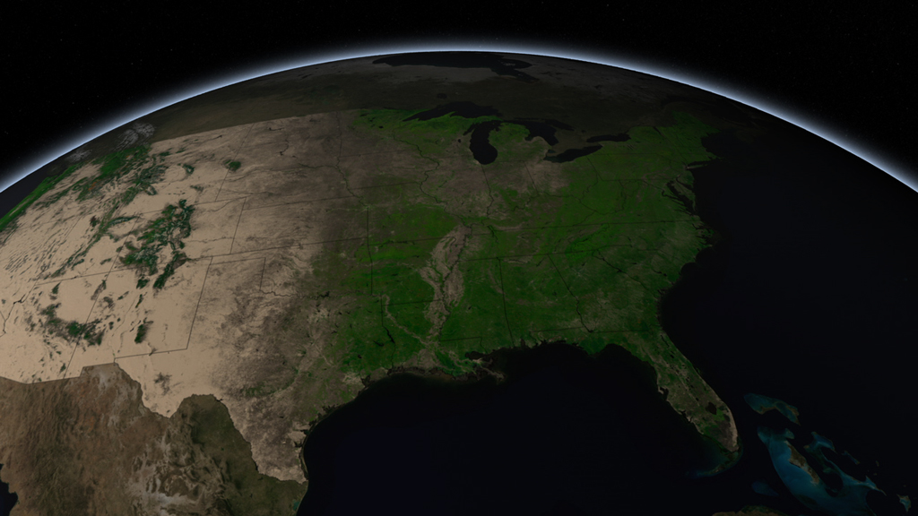
Physical Geography of the United States

Slide 3
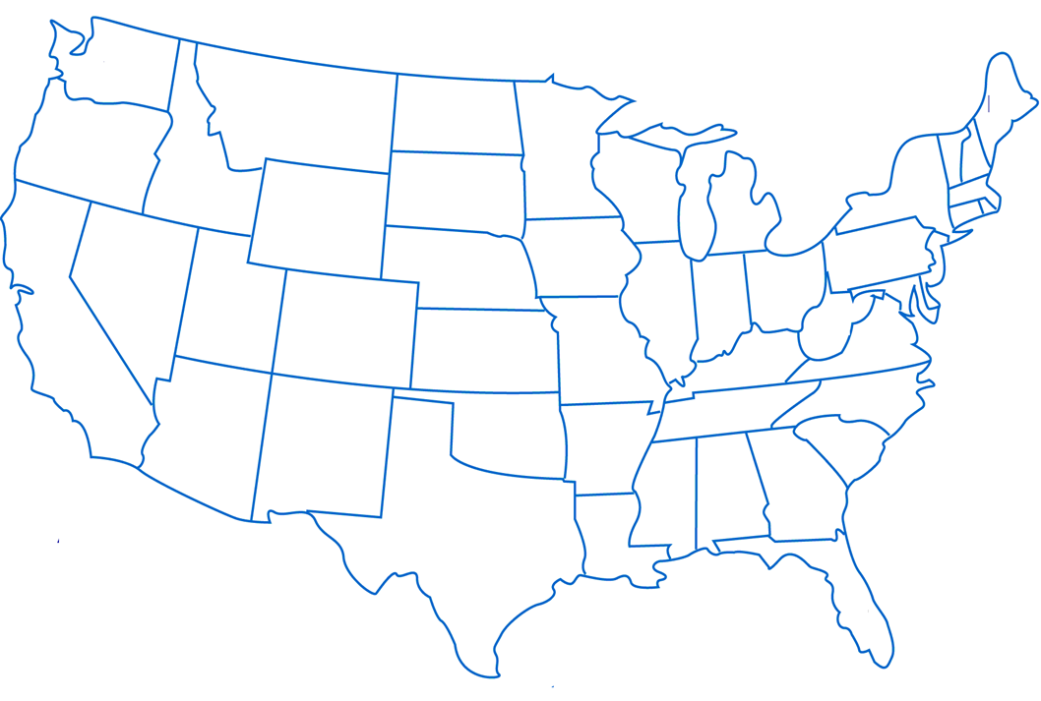
Atlantic Ocean
Pacific Ocean

Slide 4
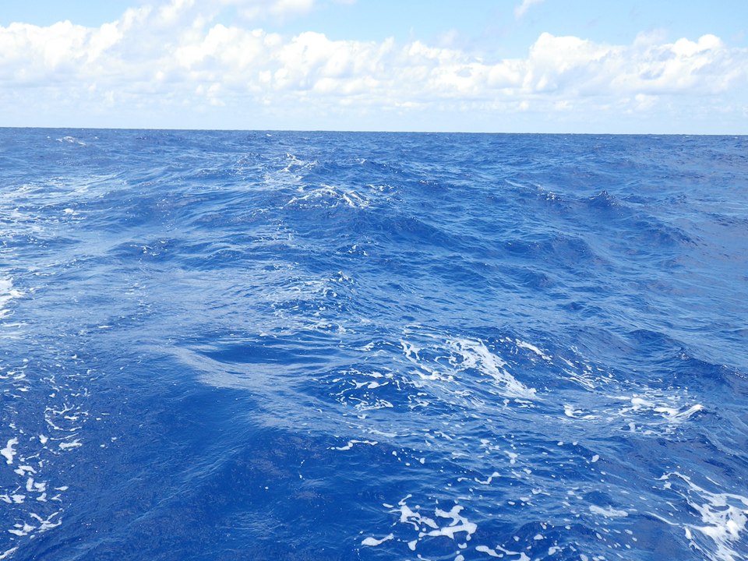

Slide 5
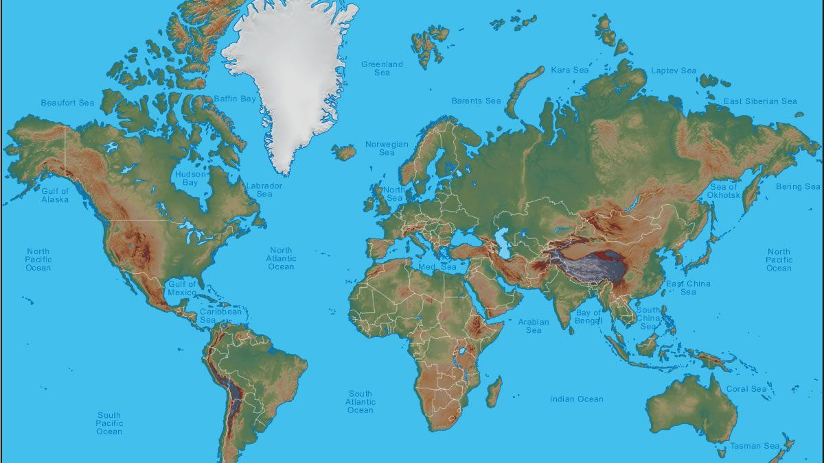
Everyone else is over here
You Are Here

Slide 6
What are the effects of having an ocean in between you and everyone else?

Slide 7
Appalachian Mountains
Atlantic Ocean
Pacific Ocean

Slide 8
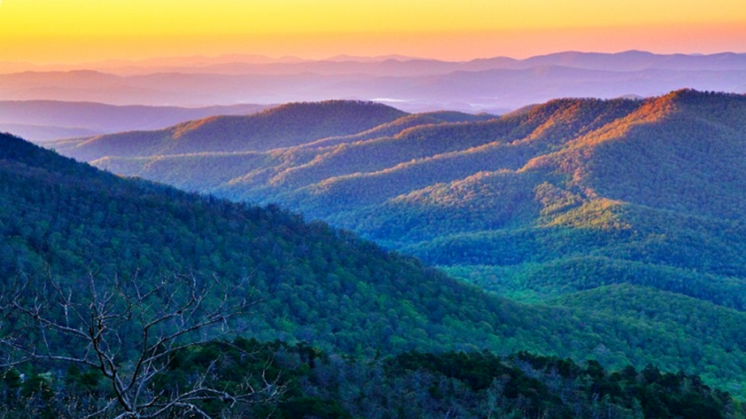

Slide 9
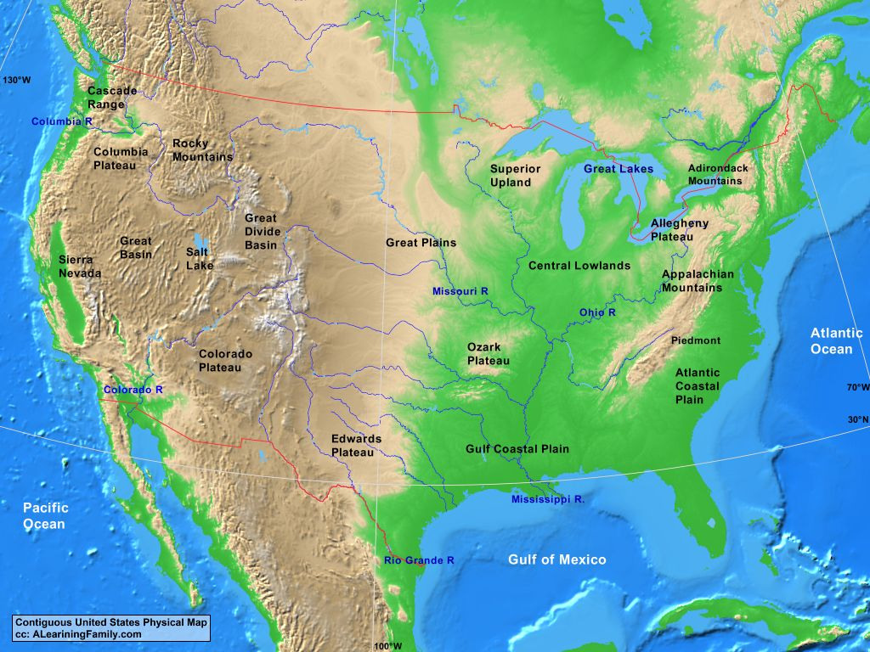
You Are Here

Slide 10
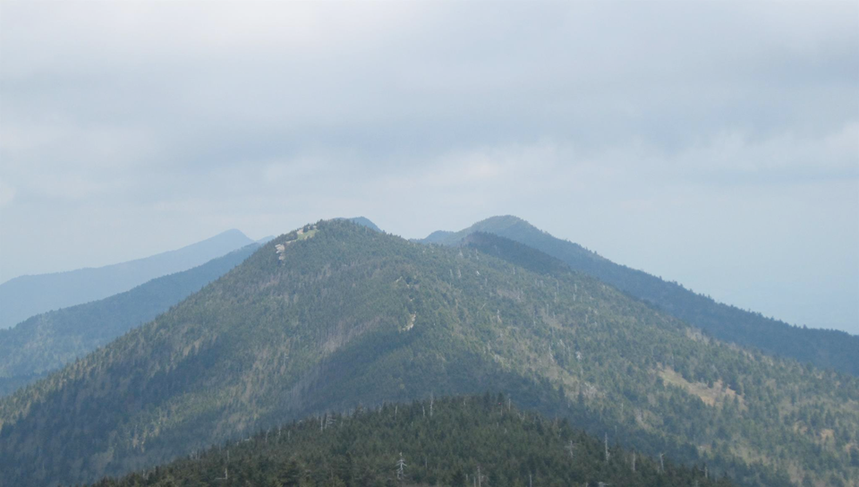
What were the effects of having the Appalachian Mountains between you and the rest of the North American continent?

Slide 11
Appalachian Mountains
Great Plains
Atlantic Ocean
Mississippi River
Pacific Ocean
Gulf of Mexico

Slide 12
Louisiana Purchase
Appalachian Mountains
Washington D.C.
Great Plains
Rocky Mountains
Atlantic Ocean
Mississippi River
Pacific Ocean
USA in 1783
Gulf of Mexico

Slide 13
