Slide 1
Demand

Slide 2
Learning Objectives
Describe the law of demand
Identify & describe the role of the substitution effect & the income effect
Explain the relationship between a demand schedule & demand curve

Slide 3
Quantity Demanded
The amount of a good that consumers are willing and able to purchase at a particular price
NOT how much of a good you want
Must be willing and able to buy that quantity

Slide 4
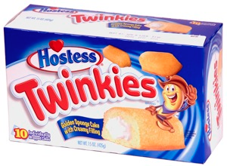
Quantity Demanded
You love Twinkies
You want 100 Twinkies
Twinkies cost $1 each
You have $10
You also need to spend $5 on gas
What is your quantity demanded of Twinkies?

Slide 5
Law of Demand
Rise in Price = Fall in Quantity Demanded
Fall in Price = Rise in Quantity Demanded
Tendency for price & quantity demanded to move in opposite directions

Slide 6
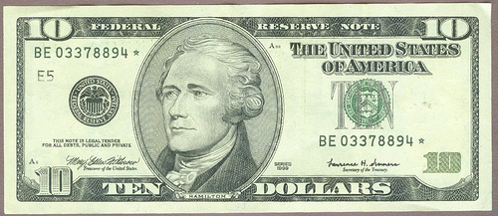
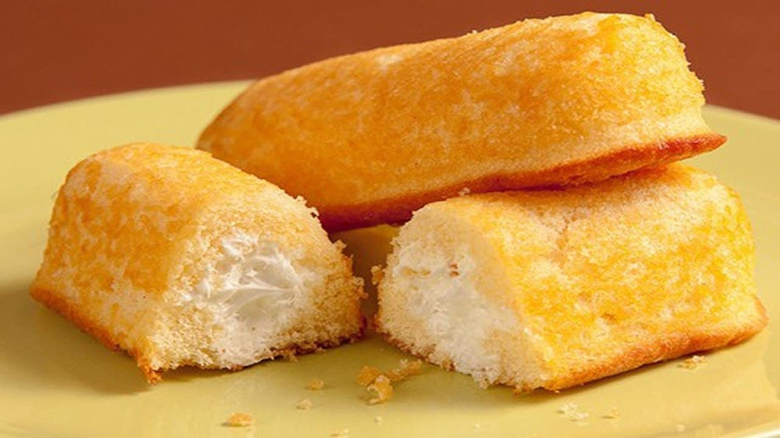
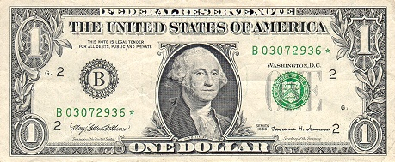
Quantity Demanded Goes Down…
As Price Goes Up…
Quantity Demanded Goes Up…
As Price Goes Down…

Slide 7
“All Else Equal”
Changes in quantity demanded assume that all else remains equal
Income, Your taste for a product, etc.

Slide 8
When Price Goes Up, Quantity Demanded Goes Down…
Substitution Effect
Income Effect
Tendency for customers to switch away from a good whose price has risen and towards other goods that have become relatively less expensive
Diminished purchasing power of your income; your money doesn’t “go as far”

Slide 9
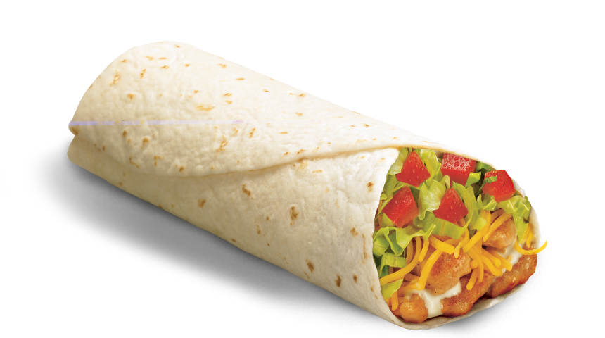
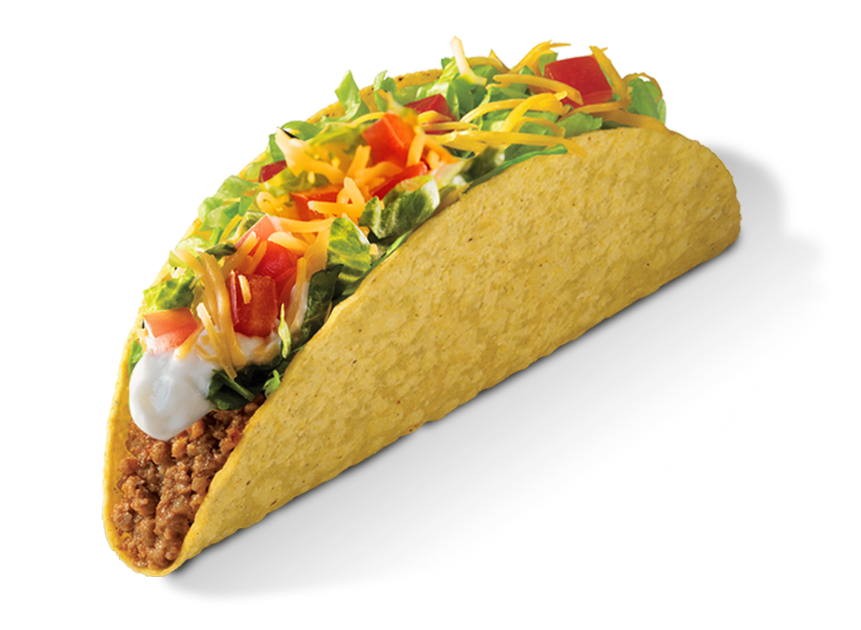
Substitution Effect
Tacos cost $1; Burritos cost $2
Opportunity cost of 1 burrito =
Price of burritos goes up to $3
New opportunity cost of 1 burrito =
Incentive to substitute tacos for burritos, because now you can get 3 tacos for every 1 burrito
2 tacos
3 tacos

Slide 10
Substitution Effect
Rise in movie ticket prices → Customers buy fewer tickets & rent more Blurays
Rise in apple prices → Customers buy fewer apples and buy more oranges

Slide 11
Income Effect
Purchasing Power – Your ability to buy something; when prices increase, your ability to purchase products (purchasing power) decreases
You make $100 per week
You can buy 100 Twinkies per week at $1 each
Price of Twinkies rises to $1.25
Now, you can only buy 80 Twinkies per week

Slide 12
Income Effect
When prices are low → $100 buys more things
Quantity Demanded goes up
When prices are high → $100 buys fewer things
Quantity Demanded goes down

Slide 13
Demand Schedule
Price (Dollars/Gallon) | Quantity of Gas Demanded (Gallons)
$2.00 | 20
$2.50 | 15
$3.00 | 10
$3.50 | 5
$4.00 | 0

Slide 14
Demand Curve
Graphical representation of the Demand Schedule
Price (Dollars/Gallon)
Quantity of Gas Demanded (Gallons)

Slide 15
Demand Curve
Change in quantity demanded due to a change in price is called a movement along the demand curve

Slide 16
Demand Curve
Graphical representation of the Demand Schedule
Price (Dollars/Gallon)
Quantity of Gas Demanded (Gallons)

Slide 17
Market Demand Curve
Graphical representation of the quantity of a good demanded by ALL consumers in the market at each price

Slide 18
Price (Dollars/Gallon) | Tom’s Demand | Fred’s Demand | Market Demand
$2.00 | 20 | 30 | 50
$2.50 | 15 | 25 | 40
$3.00 | 5 | 15 | 20
$3.50 | 0 | 10 | 10
Price (Dollars/Gallon)
Dmarket
Quantity of Gas Demanded (Gallons)

