Slide 1
Take and quietly read ONE document You may or may not have the same reading as the person next to you

Slide 2
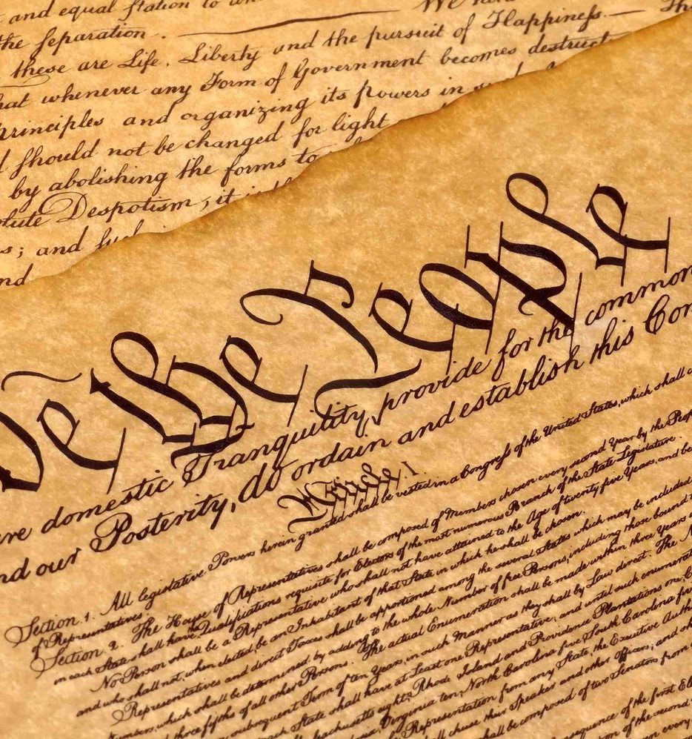
The Road to Ratification (of the U.S. Constitution)
Federalists vs. Anti-federalists

Slide 3
Ratification
To ratify something means to formally approve of it
In order for the Constitution to become the official document that the U.S. government would follow, it had to be ratified by 9 of the 13 states

Slide 4
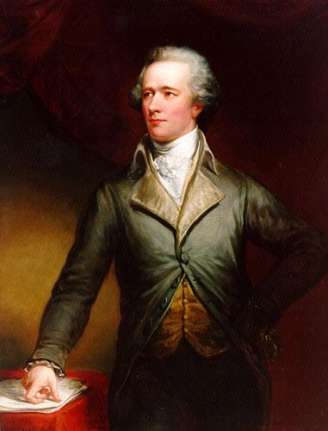
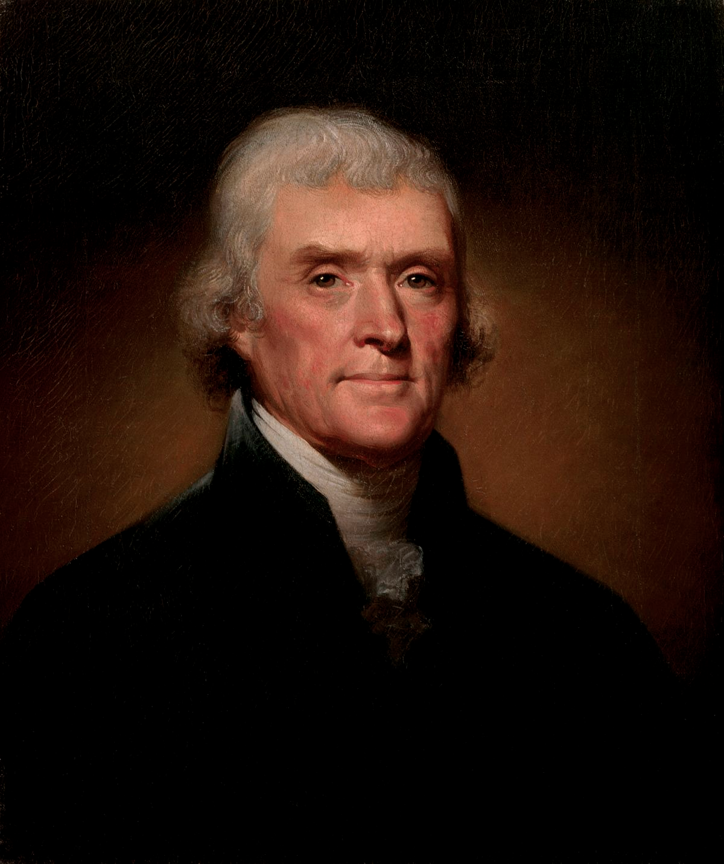
Federalists like Alexander Hamilton and Anti-federalists like Thomas Jefferson fought over ratifying the new Constitution

Slide 5
Federalists | Anti-Federalists
Favored strong national gov’t Supported the Constitution Wrote the Federalist Papers Figures such as Washington, Adams, Hamilton | Favored state and individual rights Feared too much national power and a big government Wanted a Bill of Rights before ratifying the Constitution to protect individual freedoms Figures such as Jefferson and Patrick Henry

Slide 6
What is the Bill of Rights?
The Federalists agreed to the Anti-federalists’ demand for a Bill of Rights to be added to the Constitution
The Bill of Rights are the first 10 Amendments to the Constitution
It provides a list of rights that CANNOT be taken away

Slide 7
The Bill of Rights
1st: Freedom of Speech, Religion, Press, Assembly, Petition
2nd: Right to bear arms
3rd: No quartering of troops
4th: No unreasonable search/seizures
5th: No self-incrimination; no double jeopardy; due process, compensation (eminent domain)

Slide 8
The Bill of Rights
6th: Speedy trial by jury
7th: Civil cases are still tried by a jury
8th: No cruel/unusual punishments
9th: Not every right you have is listed in the Bill of Rights (you can walk your dog on a Sunday morning)
10th: Power not given to national gov’t is given to states/the people

Slide 9
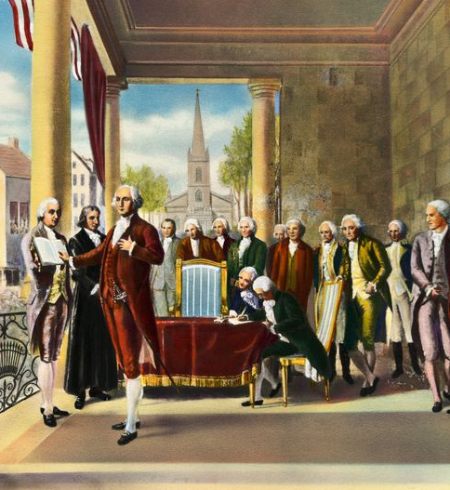
The Constitution is Ratified!
The Framers who wrote the Constitution signed it on September 17, 1787
It was officially ratified by the states on June 21, 1788
George Washington was elected unanimously by the electoral college to be the first President of the United States – he was inaugurated on April 30, 1789

Slide 10
The Federalists and Anti-federalists will return to fight each other again Stay tuned…

