Slide 1
Good Morning!
Please take a sheet, read the directions, and get started right away!

Slide 2
What is Economics? Scarcity & Tradeoffs

Slide 3
Learning Objectives
What is economics?
What are the major disciplines of economics?
What are needs and wants?
What is opportunity cost?

Slide 4
What is Economics?
Economics deals with the choices we make, individually and as a society, under the conditions of scarcity

Slide 5
Economic Disciplines
Microeconomics
Macroeconomics
The study of economics that focuses on individual people, businesses, etc.
The study of economics that focuses on society as a whole (the nation)

Slide 6
Brainstorm
Needs Wants

Slide 7
Mr. Fitzgibbons’ Needs & Wants
NEEDS
WANTS
Food
Water
Shelter
Heat
Healthcare
Steak Dinner
New Motorcycle
Cell Phone
Candy

Slide 8
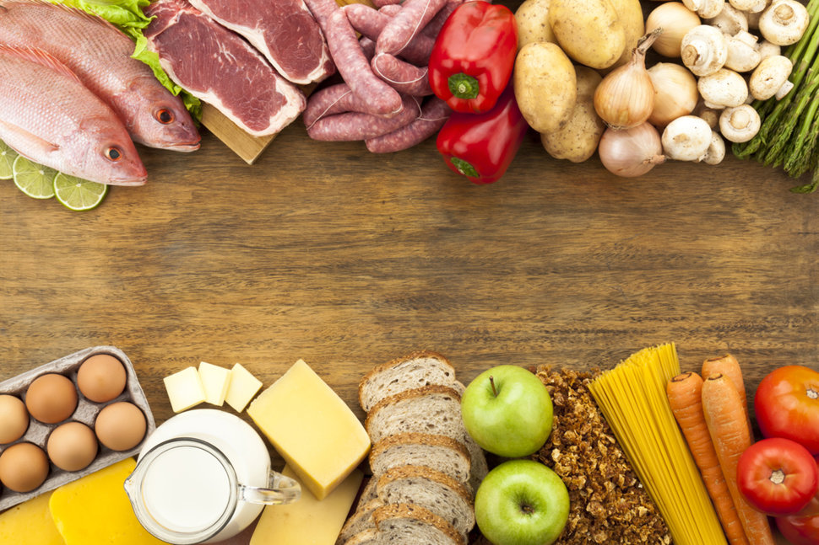

Slide 9
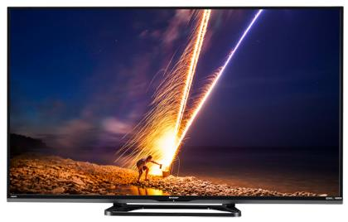
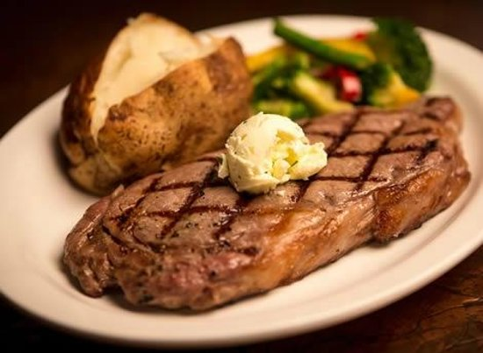

Slide 10
Can we have all of the things we need?
YES
Can we have all of the things we want?
NO – Wants are unlimited
When we desire more of something than we can have, we face a scarcity

Slide 11
Scarcity
Scarcity is the major problem that economics tries to answer
Because of scarcity, societies have to ask difficult questions:
What should we produce?
How do we produce these products?
For whom should we produce these products?

Slide 12
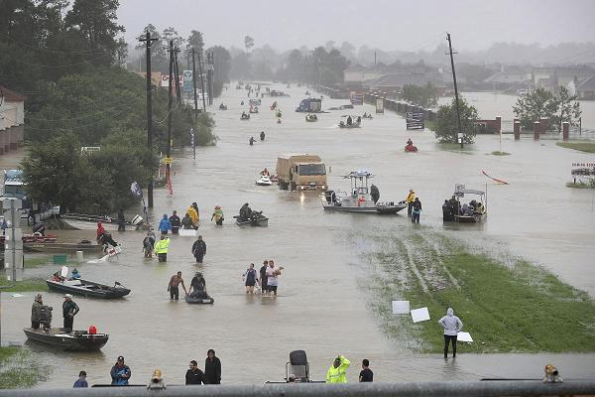
Are needs ever scarce?

Slide 13
What Else Is Scarce?

Slide 14
Can we always get everything we want?
You have $500
You want to buy 250 tacos from Taco Bell
Taco Bell doesn’t have enough tacos to sell you
They have a scarcity of tacos!

Slide 15
Can we always get everything we want?
You have $20 to spend tonight
You want to get 10 tacos from Taco Bell
You also want to see the new Marvel movie with your friends
You can’t afford both
You have a scarcity of money!

Slide 16
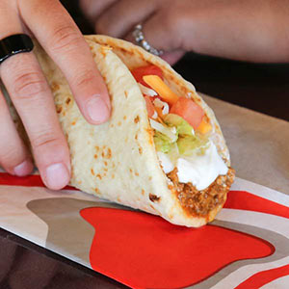
What Must You Do?
You Must Choose!

Slide 17
When You Choose, You Make A Tradeoff
Money is scarce
You give up one thing, to get another
You give up tacos to see a new movie

Slide 18
Economics Studies How People Respond To Tradeoffs
Wise individuals consider the long-term consequences of tradeoffs before making a choice
Going to school instead of sleeping in every day
Good education
Good job
Success and happiness

