Slide 1
Supply

Slide 2
Quantity Supplied
The amount of a good that firms/companies are willing to supply at a particular price over a given period of time

Slide 3
Law of Supply
As price increases, quantity supplied also increases
As price decreases, quantity supplied also decreases
The law of supply means there is a tendency for price and quantity supplied to move in the same direction

Slide 4
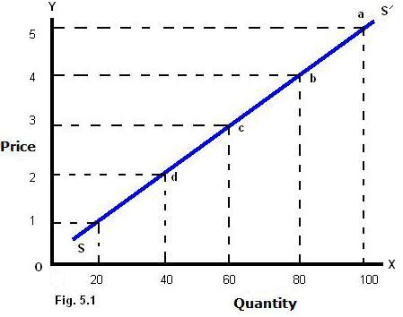
Supply Curve

Slide 5
What Causes the Supply Curve to Shift?
A change in price causes movement along the supply curve
Changing factors OTHER THAN price cause the supply curve to shift

Slide 6
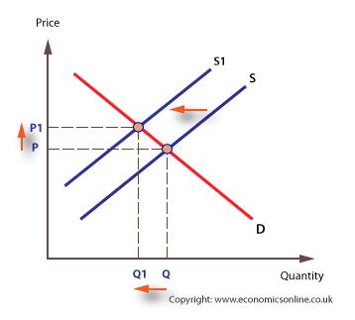
Cost of Inputs
More expensive materials & resources (factors of production) makes production more expensive → firms will supply less of a product

Slide 7
Government Policies
Higher taxes result in firms earning less revenue per unit sold; this shifts the entire supply curve
Regulations that increase input cost (such as emissions regulations) also shift the entire supply curve
Government policies usually shift the supply curve left (lower) because firms reap fewer of the benefits from supplying a product

Slide 8
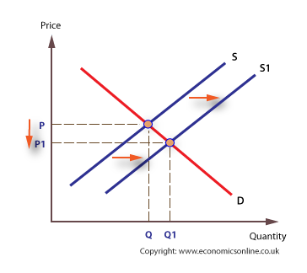
Technological Changes
New technologies that decrease production costs (faster production, lower labor costs, etc.) cause firms to increase their supplies

Slide 9
Natural Disasters
Natural disasters such as hurricanes, tsunamis, forest fires, earthquakes, etc. can increase the scarcity of factors of production
Natural disasters tend to decrease supply and shift the supply curve to the left

