Slide 1
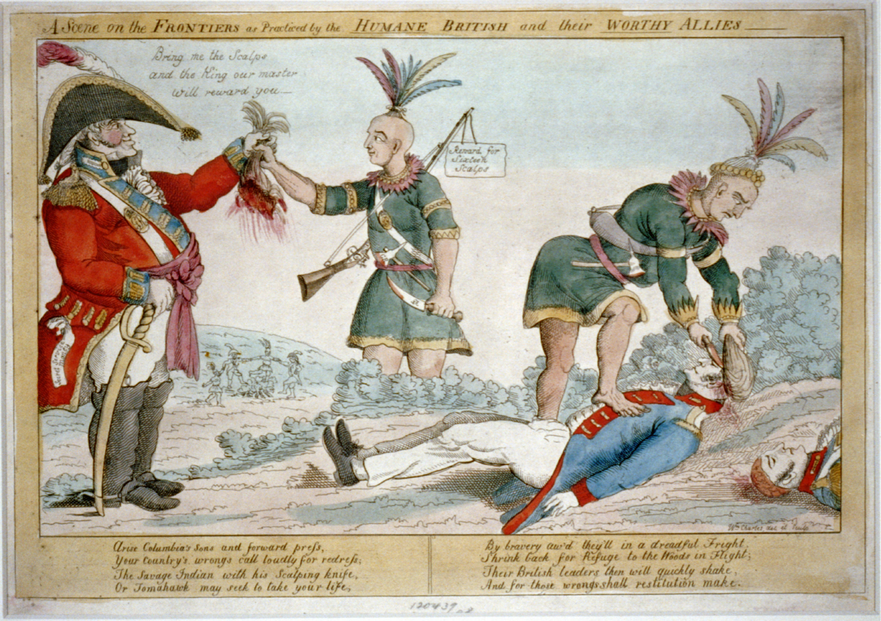
Do Now
Take a cartoon from the front of the room
Make at least 5 observations and 3 inferences about the cartoon

Slide 3
Observations
Inferences

Slide 4
The Battle of Tippecanoe
In late 1811, a Native American named Tecumseh began building an armed resistance to fight American expansion
He was upset over dishonest land treaties that took their land
While Tecumseh was building an army of natives, Governor William Henry Harrison of the Indiana Territory led troops to the native town Prophetstown
A battle ensued along the Tippecanoe River – the Americans burned Prophetstown but most of the Native Americans escaped

Slide 5
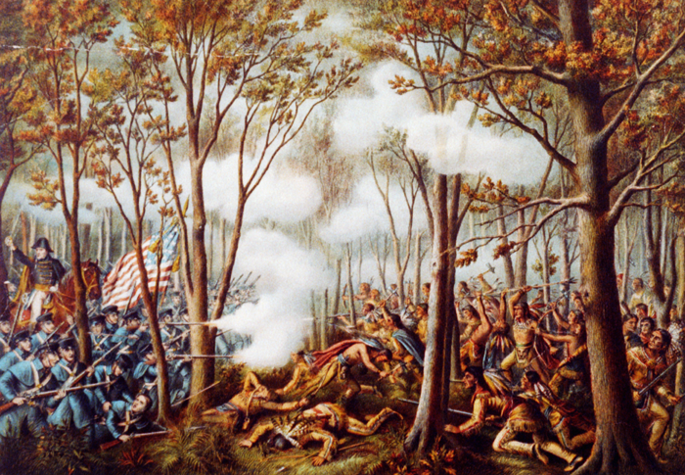

Slide 6
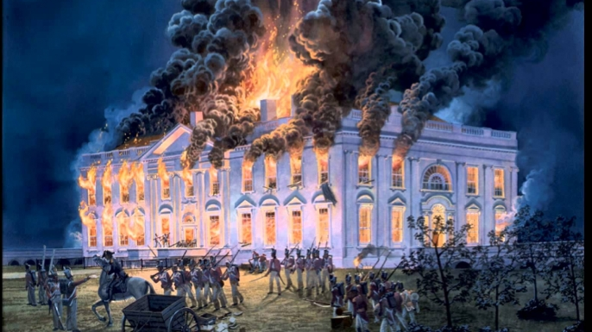
The War of 1812: England Strikes Back

Slide 7
England vs. France (AGAIN!)
During Jefferson’s presidency, the United States traded with France
England, who was at war with France, was unhappy with the United States’ trade arrangement with the French so they began stopping and confiscating American merchant ships
England also impressed American sailors – U.S. sailors were taken from their ships and forced to serve in the British Navy
By 1812, 6,000 American sailors had been forced to serve in the British Navy

Slide 8
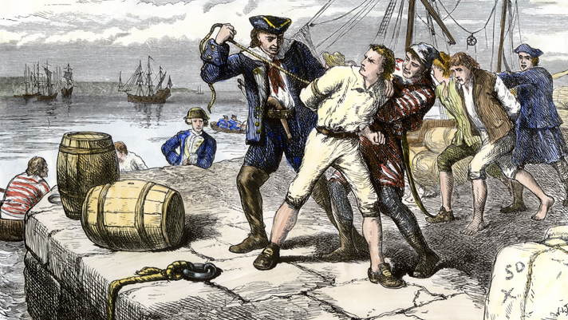

Slide 9
Jefferson’s Embargo
Both Federalists and Democratic Republicans became outraged with the British policy of impressment
Jefferson knew the young U.S. Navy could not compete with the British Navy in open warfare, so he asked Congress to declare an embargo
Under the embargo, the U.S. stopped all trade with England
Jefferson hoped the embargo would hurt the British economy, but it backfired and hurt American merchants and farmers
Jefferson lifted the embargo before retiring from the Presidency in 1809

Slide 10
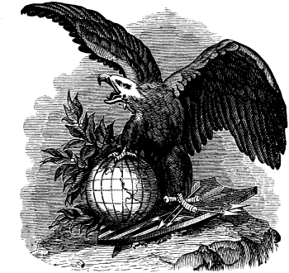
The War Hawks
Many people in Congress wanted to go to war with England
The War Hawks argued that England had to pay for the impressment of American sailors and their support for Native American attacks on the U.S.
Henry Clay from Kentucky & John Calhoun from South Carolina were prominent War Hawks who wanted to go to war with England and invade British-held Canada

Slide 11
The U.S. Goes to War
Congress, thanks to urging by President James Madison, declared war on Britain in 1812
The U.S. planned to invade Canada rather than build up a navy to invade England
The Canada invasion failed miserably because of Native American support for the British
The British retaliated with an invasion of the United States mainland and marched on Washington D.C. where they burned the White House

Slide 13
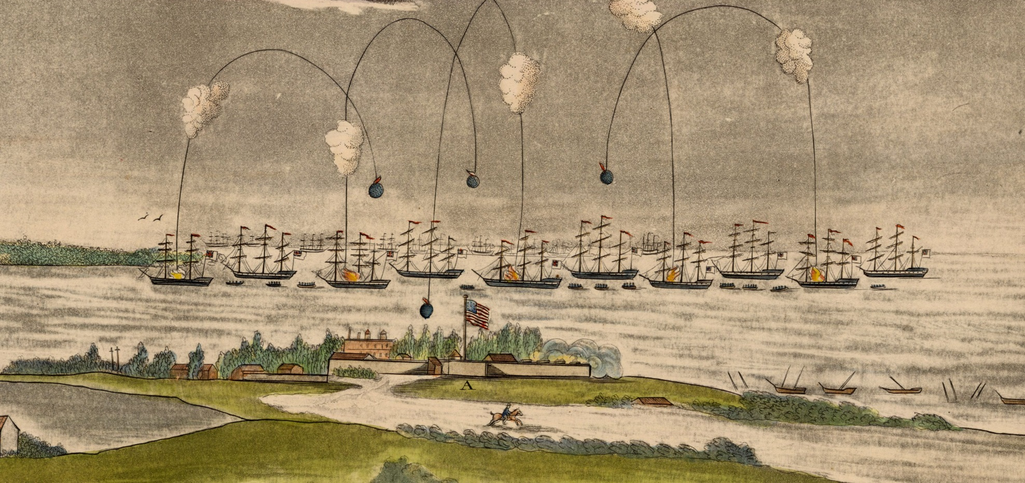
The British Fail in Baltimore
After conquering D.C., the British marched on Baltimore, where they fought to capture Fort McHenry
American troops managed to hold the fort as Francis Scott Key watched from a prison ship and recorded the attack in a poem
The poem was called The Star Spangled Banner and would later become the United States National Anthem

Slide 14
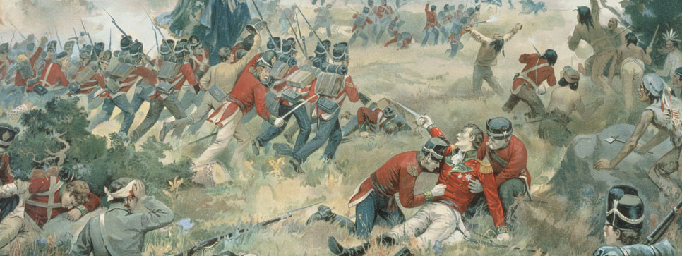
Trivia Fact: The War of 1812 is the ONLY time the United States has been invaded by an enemy army

Slide 15
The End of the War
The Treaty of Ghent ended the War of 1812
Both England and the U.S. had grown tired of fighting, so they ended the war and agreed to return to the status quo
Nothing about impressment was officially stated in the treaty
The War of 1812 is called America’s “2nd War of Independence” because the U.S. proved that their defeat of the British in the Revolutionary War was legit

Slide 16
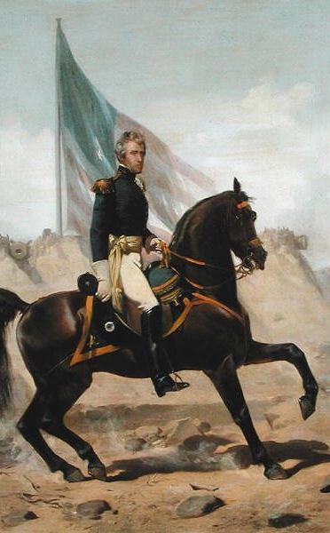
Battle of New Orleans
The Battle of New Orleans served as a major American victory
The Americans suffered only 71 casualties compared to England’s 2,036
General Andrew Jackson (future President!) became an American icon and hero because of the battle
The Battle of New Orleans took place AFTER the War of 1812 ended with the Treaty of Ghent (it took too long for news to reach New Orleans!)

Slide 17
War of 1812
Expansion, Nationalism, or Sectionalism?

Slide 18
https://www.youtube.com/watch?v=0_TVABIVG4Y

