Slide 1
Taft’s Dollar Diplomacy & Wilson’s Moral Diplomacy

Slide 2
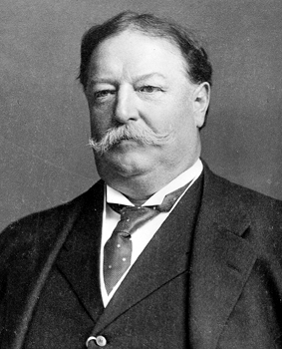
William H. Taft and Dollar Diplomacy
President Taft’s foreign policy depended more on investors’ dollars than aggressive militarism
His policy of promoting U.S. trade by supporting American business abroad came to be known as “dollar diplomacy”

Slide 3
Dollar Diplomacy in East Asia & Latin America
Taft believed private American financial investment in China and Central America would lead to greater stability in those regions
Taft’s policies met one big obstacle: growing anti-imperialism in America and abroad
America was able to participate in joint construction of railroads in China, but Russia and Japan excluded America from building railroads in northern Manchuria
U.S. also had to intervene in a civil war in Nicaragua to protect American investments

Slide 4
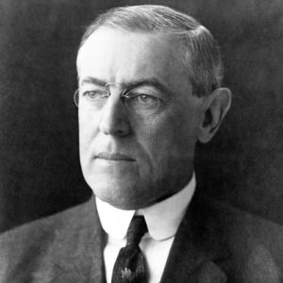
Woodrow Wilson & Foreign Affairs
President Wilson promised a moral approach to foreign affairs
Said he opposed imperialism, the big-stick, and dollar-diplomacy policies of his predecessors

Slide 5
Wilson’s Moral Diplomacy
Wilson took specific steps to correct what he thought were wrongful policies of the past:
Philippines- Jones Act of 1916 granted full territorial status, guaranteed a bill of rights and universal male suffrage, promised independence as soon as a stable govt. was established
Puerto Rico- an act of Congress granted U.S. citizenship and provided for limited self-government
Panama Canal- Wilson persuaded Congress to repeal an act that exempted U.S. ships from paying standard canal tolls
Tried to negotiate international treaties that lessened tensions between nations before conflict could break out

