Slide 1
Key Vocabulary
Government: The institution through which a society makes and enforces public policies
Public Policy: All of the things a government decides to do
State: A body of people, living in a defined territory, with a government that can make and enforce laws
Legislative Power: The power to make laws
Executive Power: The power to enforce laws
Judicial Power: The power to interpret laws

Slide 2
What is a government?
A government makes and enforces public policies via the three sources of power (legislative, executive, and judicial) for a given state

Slide 3
The “State”
Does not refer to the 50 states in the USA
A state is the main unit of government in the world today – each country is considered a “state”
There are over 200 states, varying in size, population, and power
Every state has 4 basic characteristics:
Population
Territory
Sovereignty
A Government

Slide 4
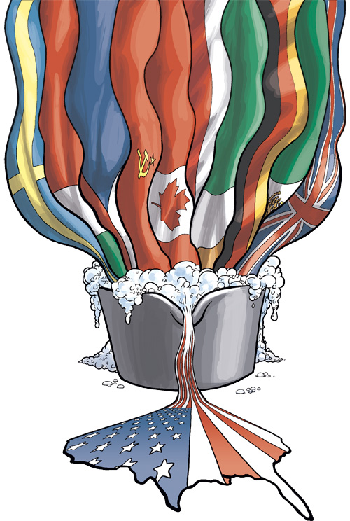
Population & Territory
Every state must have a population (people)
Populations can be large or small
They can be diverse or homogenous

Slide 5
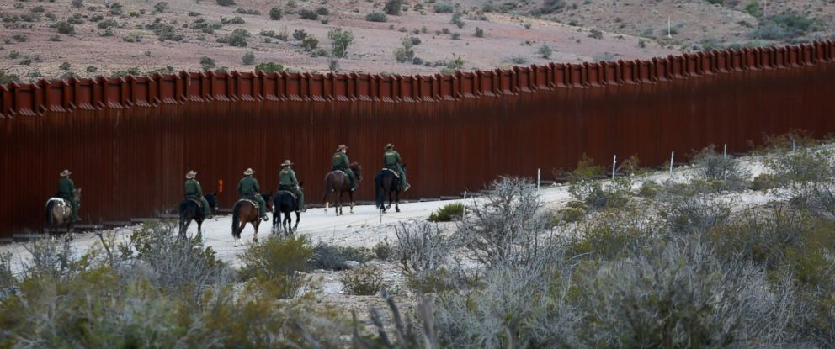
Population & Territory
Every state must have territory
It must have land, as well as recognized borders

Slide 6
Sovereignty
Sovereignty = power or authority
A state must have power or authority over its own governance in order to decide public policies
If a state answers to another state, it is not sovereign

Slide 7
A Government
Every state must have a government to create and enforce its public policies

Slide 8
Where Does a State Get It’s Power?
There are four theories that attempt to answer from where a state/government originates/gets its power

Slide 9
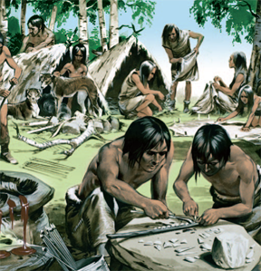
Theory 1: Evolutionary Theory
Primitive families spread out and settled in different regions – the heads of these families then formed governments and created states

Slide 10
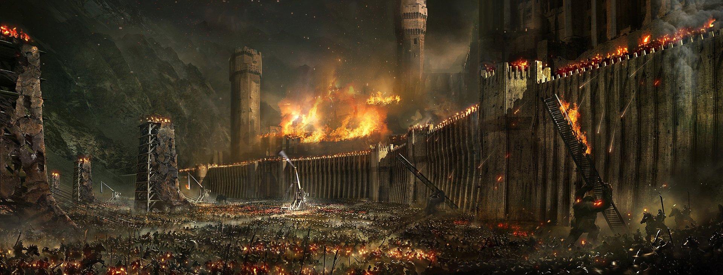
Theory 2: The Force Theory
An individual or group claims control over a territory & population and forces the population to submit
Those in control form a government and a state

Slide 11
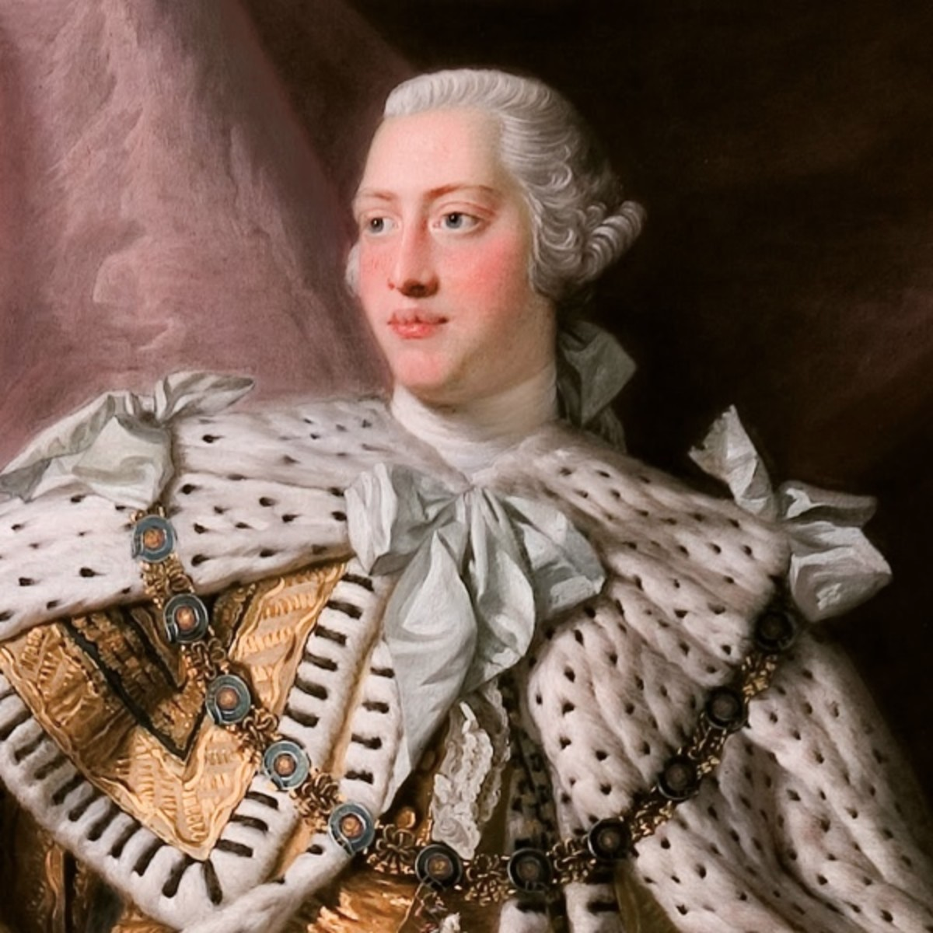
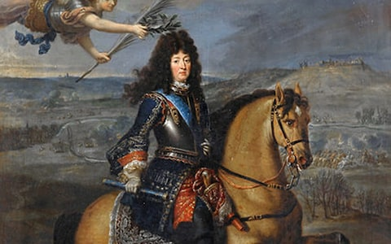
Theory 3: The Divine Right Theory
God creates a state and chooses leaders for the government
The ruler gets their credibility & power from God

Slide 12
Theory 4: Social Contract Theory
Developed by Enlightenment Era philosophers like Locke, Hobbes, & Rousseau
People choose to give power to a government for the well-being of society and that all political power comes from the people
The United States subscribes to the social contract theory

Slide 13
Theory 4: Social Contract Theory
The people can withhold power from an unjust government
In fact, many believe it is the people’s obligation to withhold power from an unjust government

Slide 14
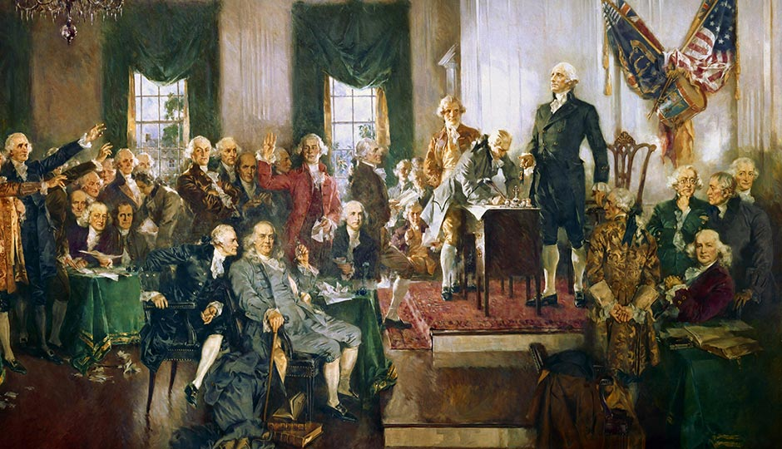
Theory 4: Social Contract Theory

